Slide 1
Work Update – Aug 22nd
Giulio

Slide 2
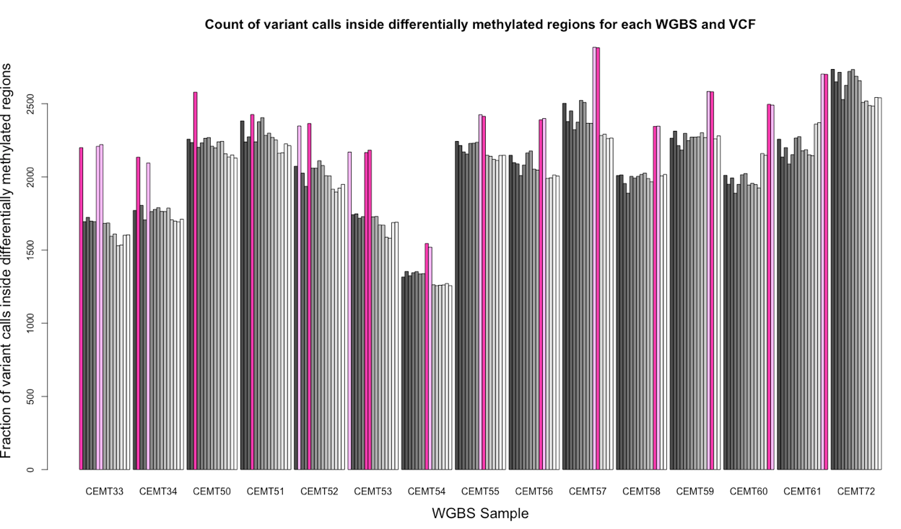
What: Colocalization of genetic and epigenetic variants
-Goals
Probe the interplay of genetic and epigenetic variants across normal and malignant tissue.
Evidence for genetic variants causing epigenetic variants:
QTL studies show causality (Das 2015, Kilpien 2013, McVicker 2013).
Prelim results: colocalization above statistical baseline.
Strategy
Probe the interplay of genetic and epigenetic variants across normal and malignant tissue.
Compare colocalization in different conditions: VC effects, functional regions, CGIs and histone enrichment.
Difference in colocalization across normal and cancer samples suggests a change in regulatory machinery.
Colocalization of VCs with DMRs between normal samples of different people acts as a baseline of naturally occurring DMRs, some explainable by VCs, some not.
Colocalization of VCs with DMRs between normal and tumour samples as measurement of genetic variants impacting epigen, or machinery damage affecting global epigen patterns.
Tumour adjacent as baseline for natural variation between similar samples, or as intermediate sample.
I expect a larger fraction of tumor DMRs to not be explainable by VCs, but tumour will have many somatic mutations and resulting DMRs.

Slide 3
Models
(1) Mutations in binding domains -| TF binding -| gene expression -> local epigenetic change (Matsubara 2012)
(2) Mutation on Cis-regulatory epigenetic signals -> local epigenetic change
(3) Mutation on Trans-regulatory DNA (ncRNA? 3D chromatin?) -> distal epigenetic change
(4) Mutation on epigenetic machinery (HATs, HMTs, HDACs, etc) -> global change in epigenetic regulation
4
DNMT
1
3
2
3D conformation
ncRNA
Global demethylation
Methyl (DMR) &
Hist mods (DHM)
TF
Methyl (DMR) &
Hist mods (DHM)
Methyl (DMR) &
Hist mods (DHM)
Many VCs do not colocalize with DMRs. Expected in tumors compared to normal cells.
expression
Some VCs do not colocalize with DMRs. Requires sequence similarity and DE analysis to estimate properly
Some VCs colocalize with DMRs. Maybe differentiate between (1) and (2) by annotations of VCs (upstream, nc, etc…)

Slide 4
How: Integrating data by region
Data available
WGS -> parse VCF to obtain info about region-function, effect on gene, severity, biotype, zygosity, quantity, etc
WGBS -> run chi squared analysis to find DMRs. Groups by each patient (Tum, tumAdj, Norm) and by each cell type (Tum, Norm)
ChIP-seq -> from findER2 enrichment files, label each region as mostly enriched or not
CGI positions -> from hg38 files, classify if region is mostly a CGI or not
Not used: RNA-seq and miRNA-seq. DE analysis would be too time consuming and not contribute significantly to analysis
Strategy
Split genome into 400bp chunks to find DMRs, then integrate all datatypes describing each chunk.
400bp is large enough to have good coverage in WGBS across chi squared thresholds.
400bp is small enough to avoid conclusions over unrelated genomic regions (CpG methylation influences up to 2kb region according to Tony).
Edge effects can cause issue, but shouldn’t be significant across whole genome.
Groupings for DMR analysis with chi squared
normal vs. tum adj vs. tumor (for each of 6 patients) -> information about tumor formation
All normal samples (of all 6 patients) -> baseline amount of DMRs explainable by VCs
All tumor samples (of all 6 patients) -> too varied to be a baseline, but a useful sanity check

Slide 5
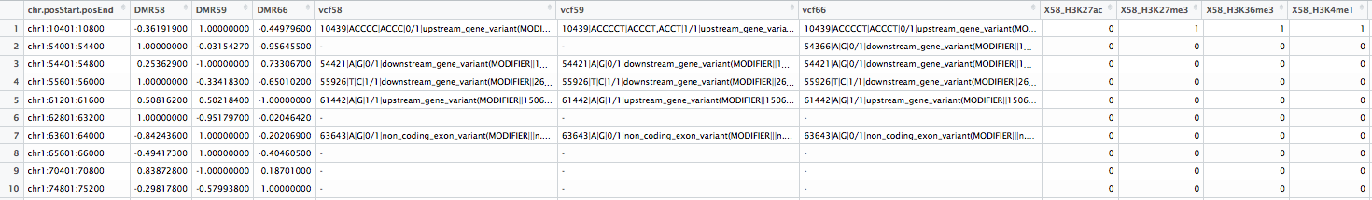
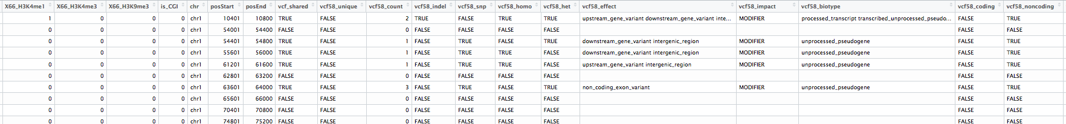
Comparison data tables with all the info

Slide 6
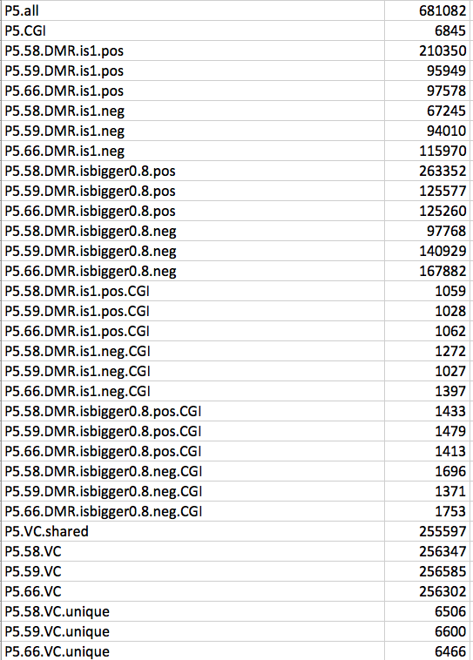
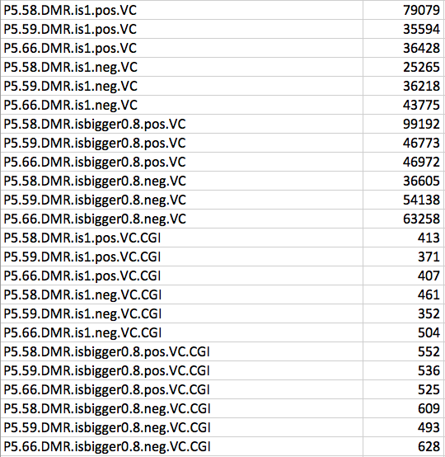
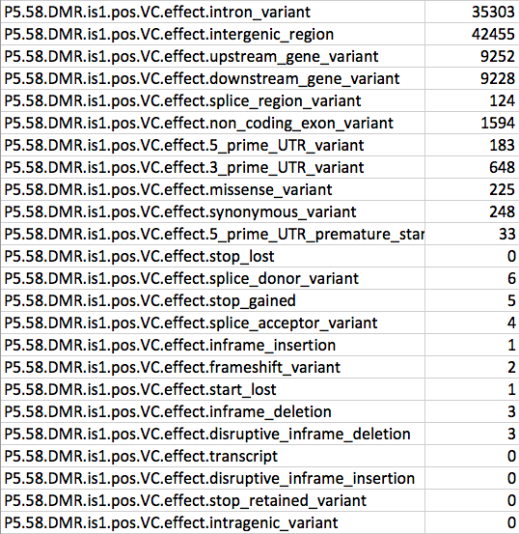
Count entries with specific conditions
Total amounts for reference
Counts of VCs in each condition
Break down of each group or condition
Different cutoffs

Slide 7
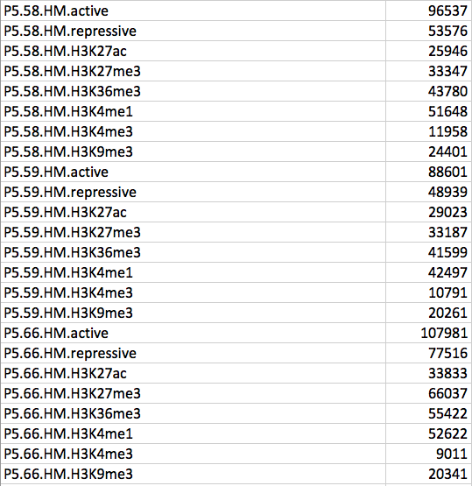
Count entries with specific conditions
Same with Histone Mods

Slide 8
Early results
Validation plots
Differential methylation in cancers
Variant Calls colocalizing with Differentially Methylated Regions
Robustness checks
Histone Mods

Slide 9
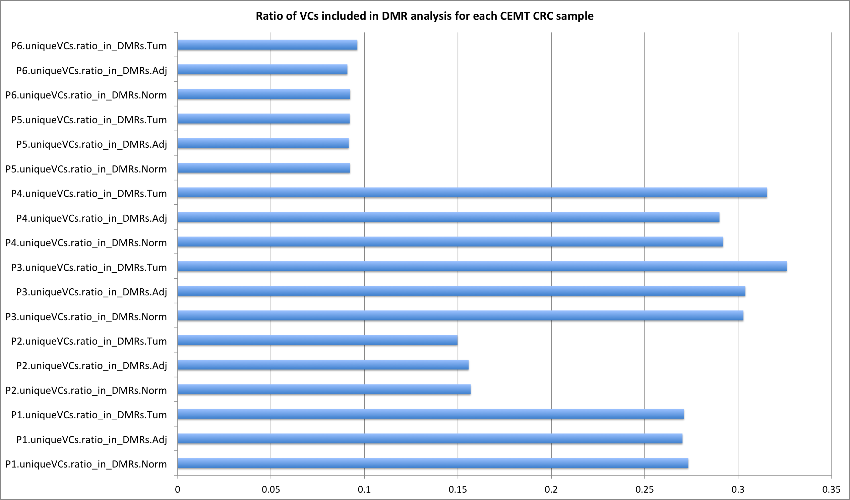
Validation plots

Slide 10
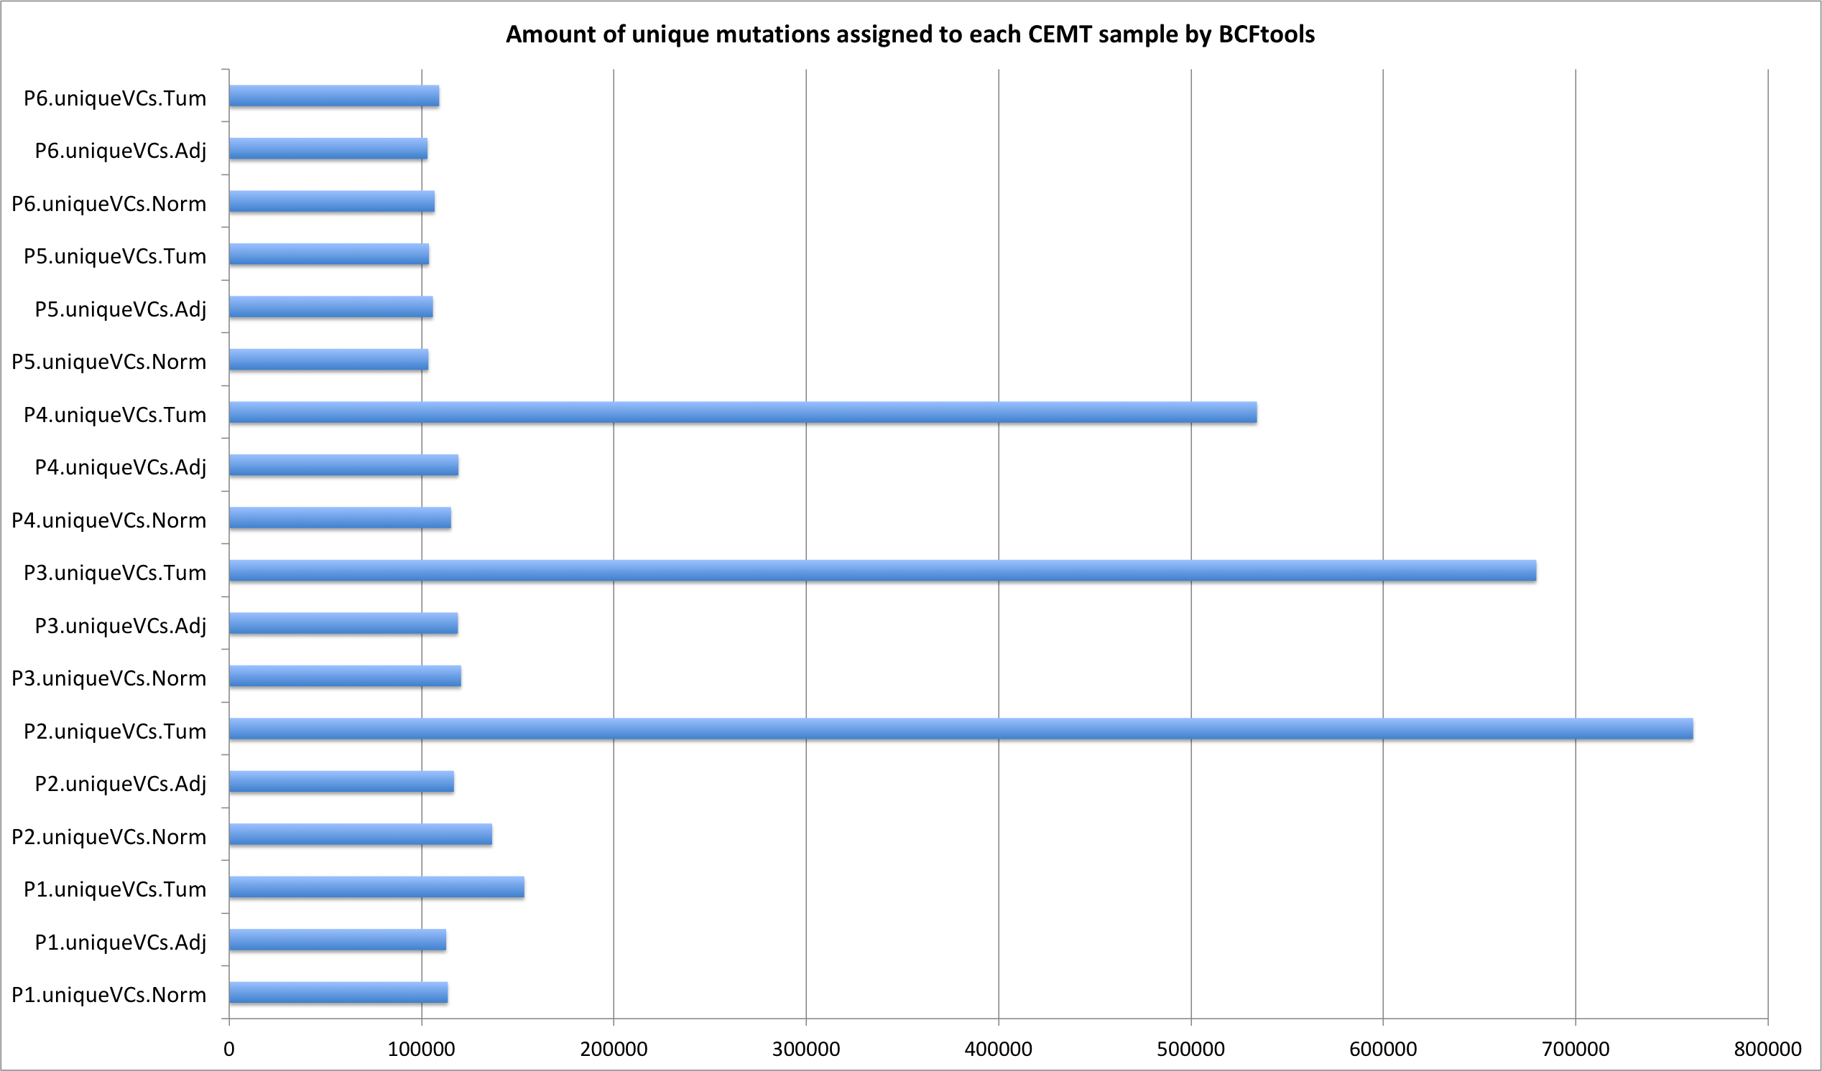
Validation plots

Slide 11
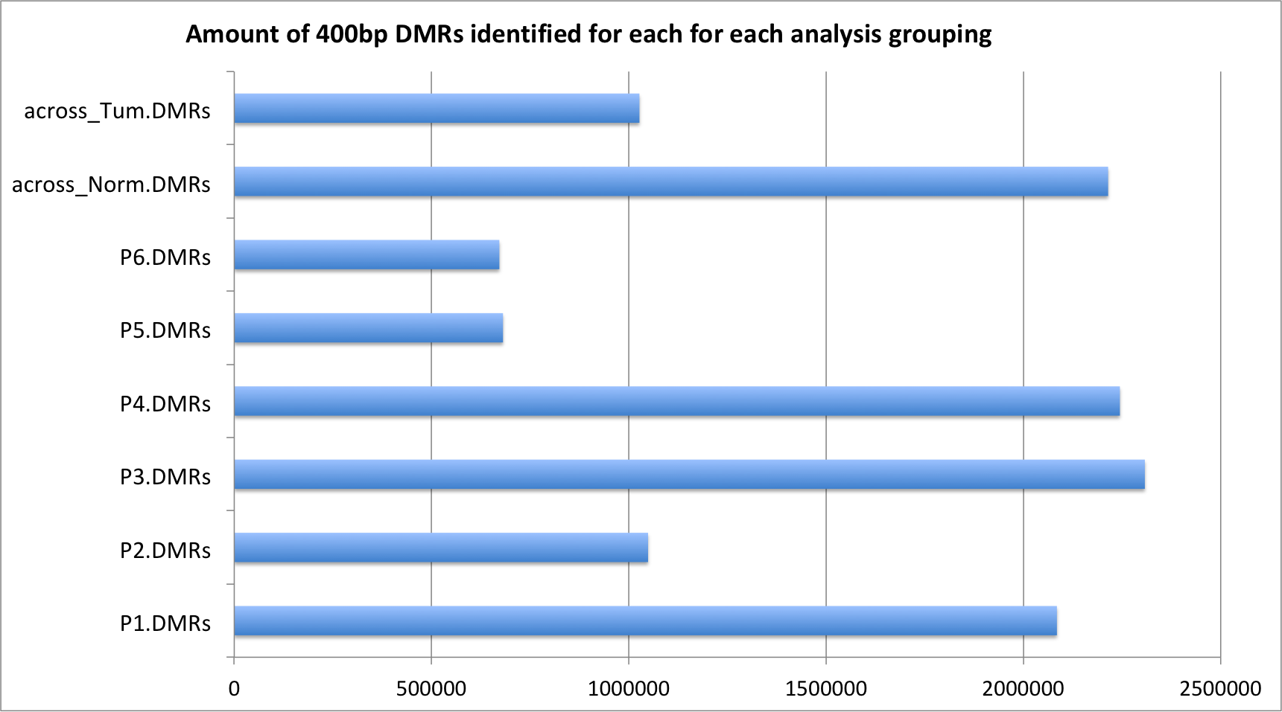
Validation plots

Slide 12
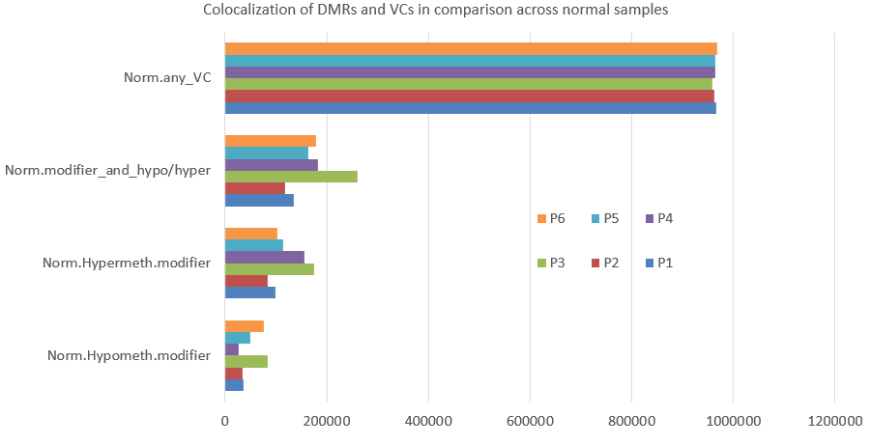
Validation plots

Slide 13
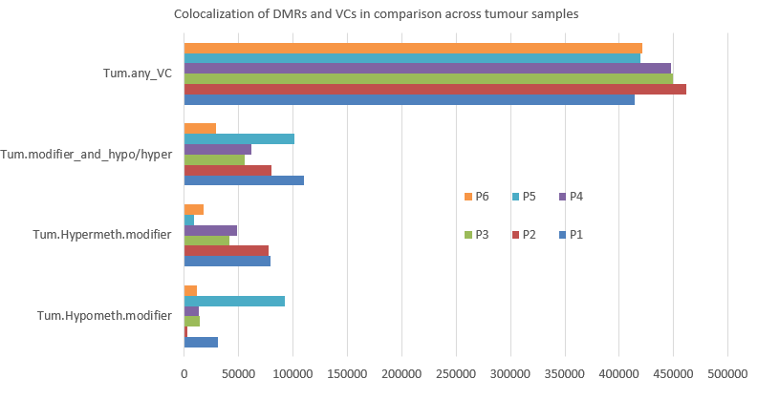
Validation plots

Slide 14
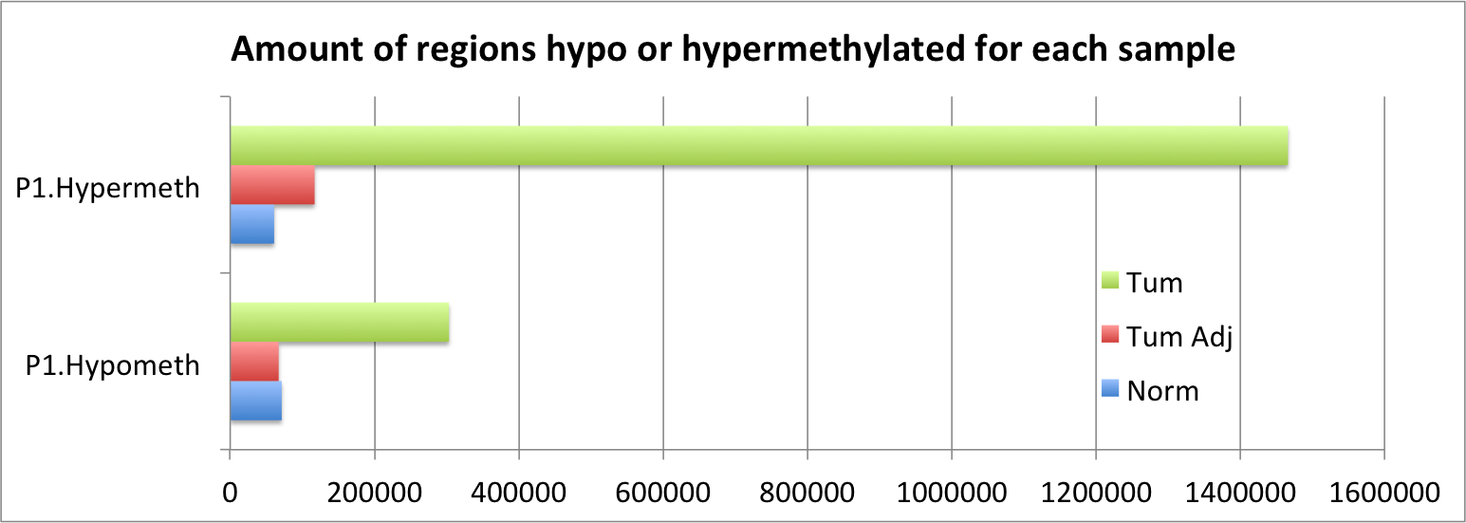
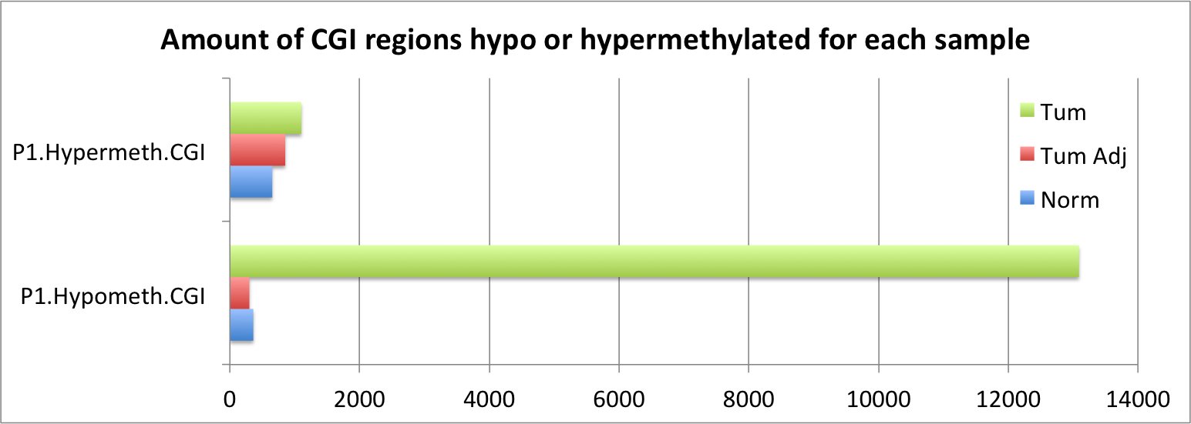
Differential methylation in cancers

Slide 15
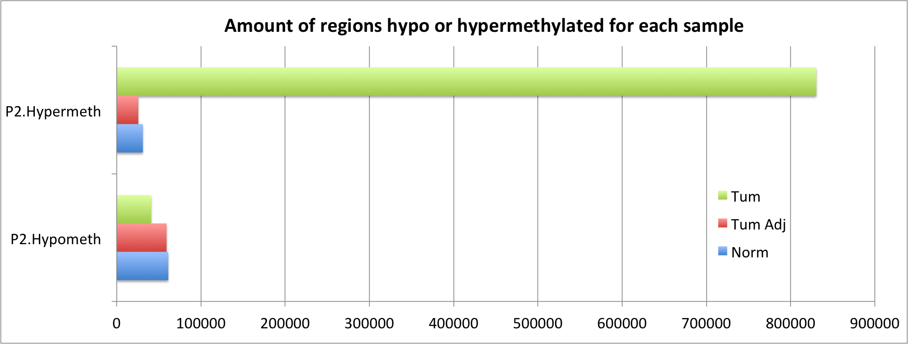
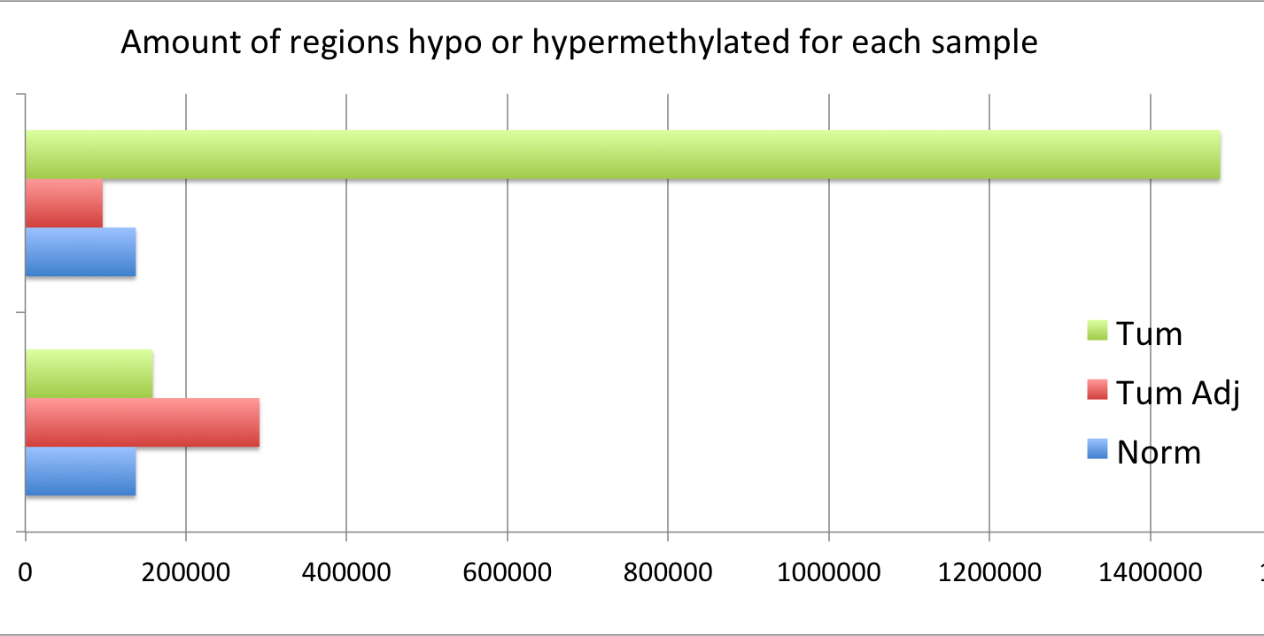
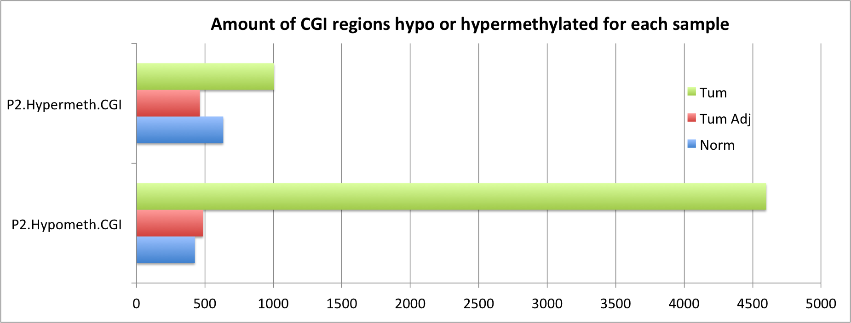
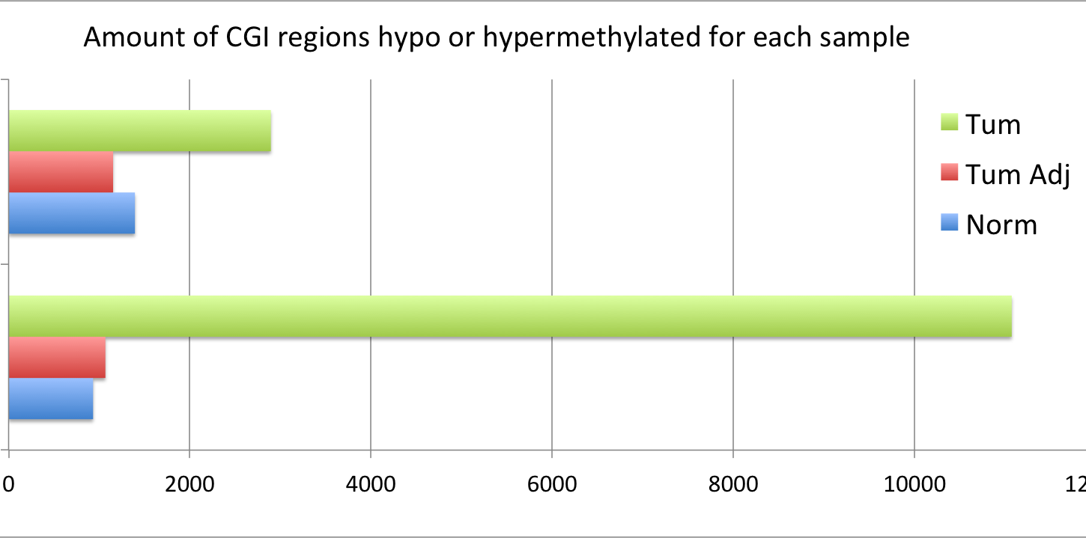
Differential methylation in cancers

Slide 16
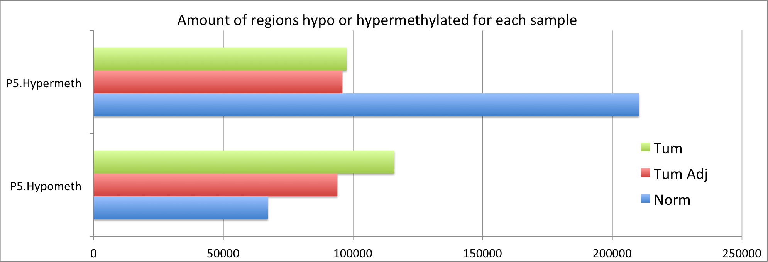
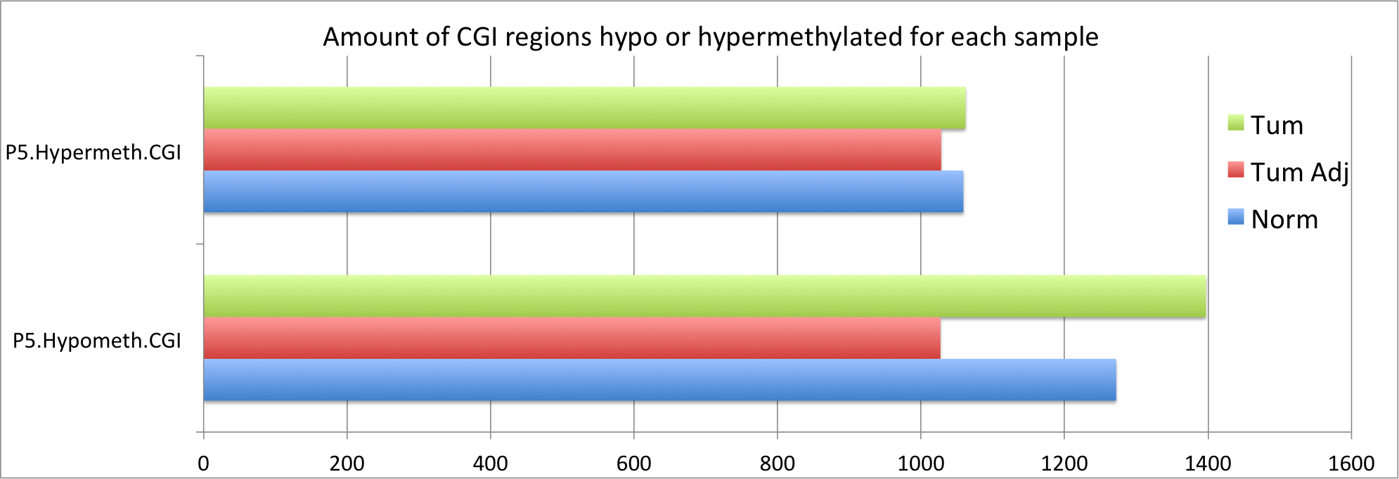
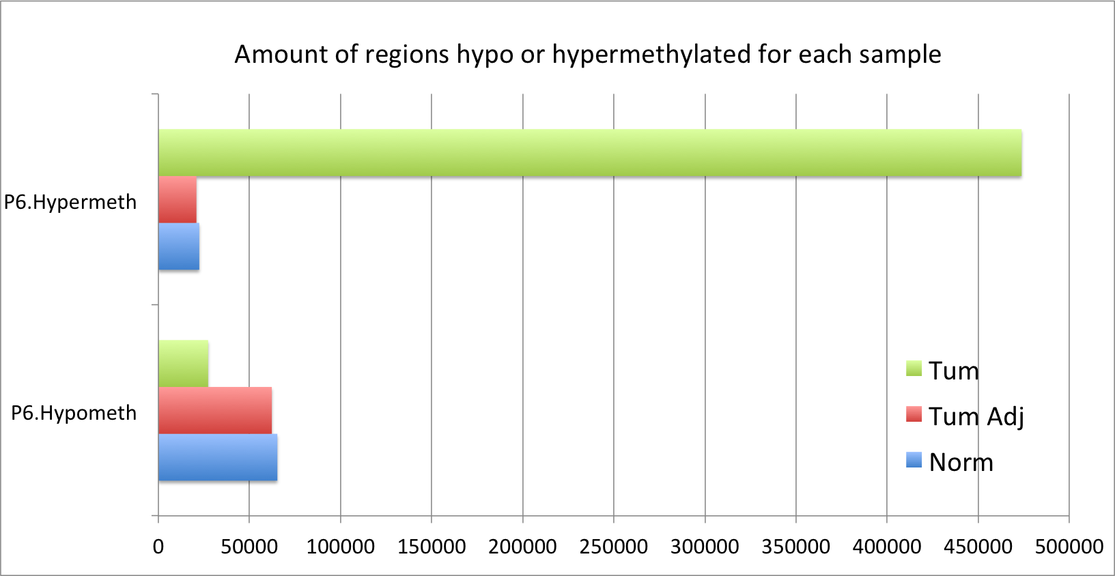
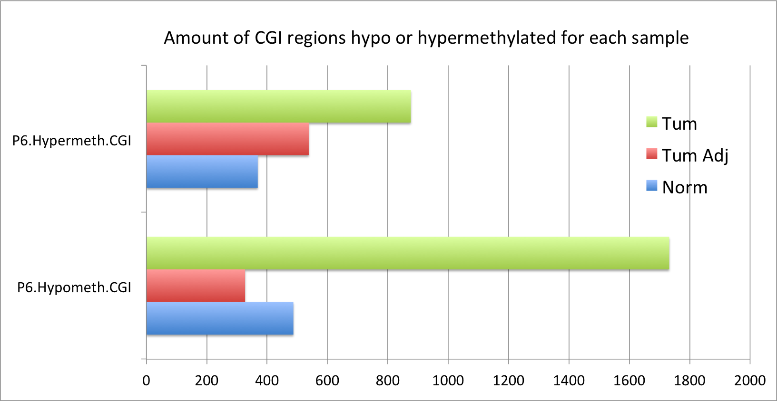
Differential methylation in cancers the undermutated tumours

Slide 17
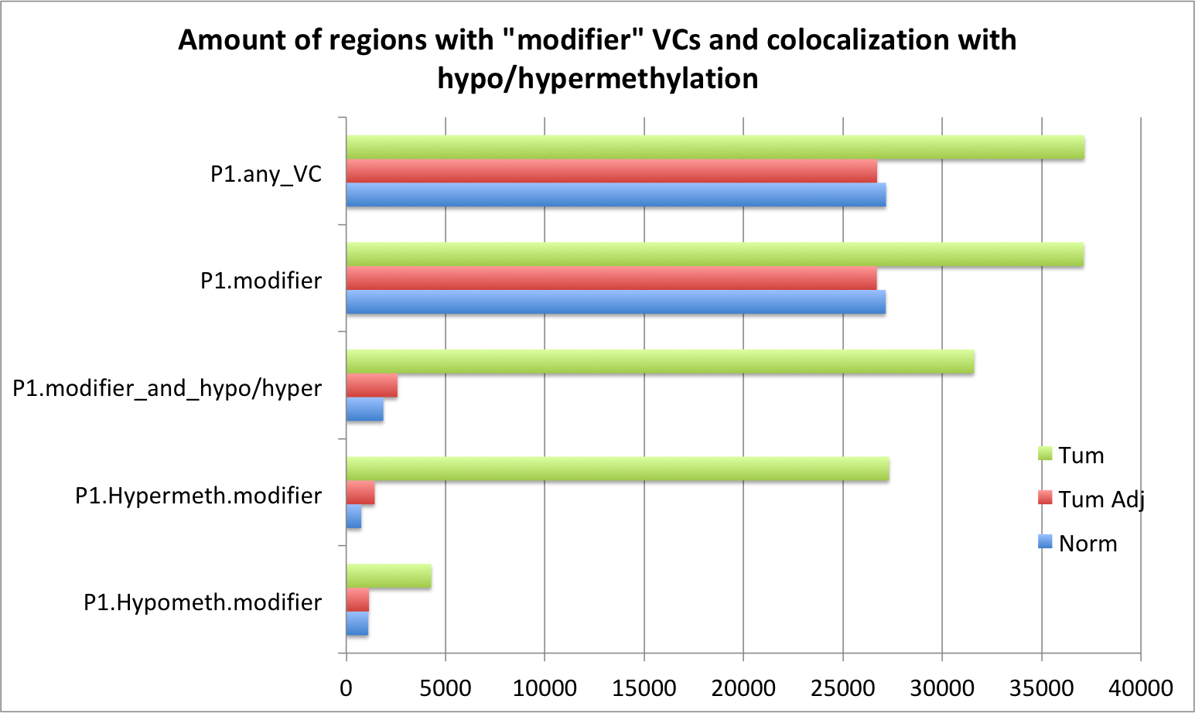
Variant Calls colocalizing with DMRs

Slide 18
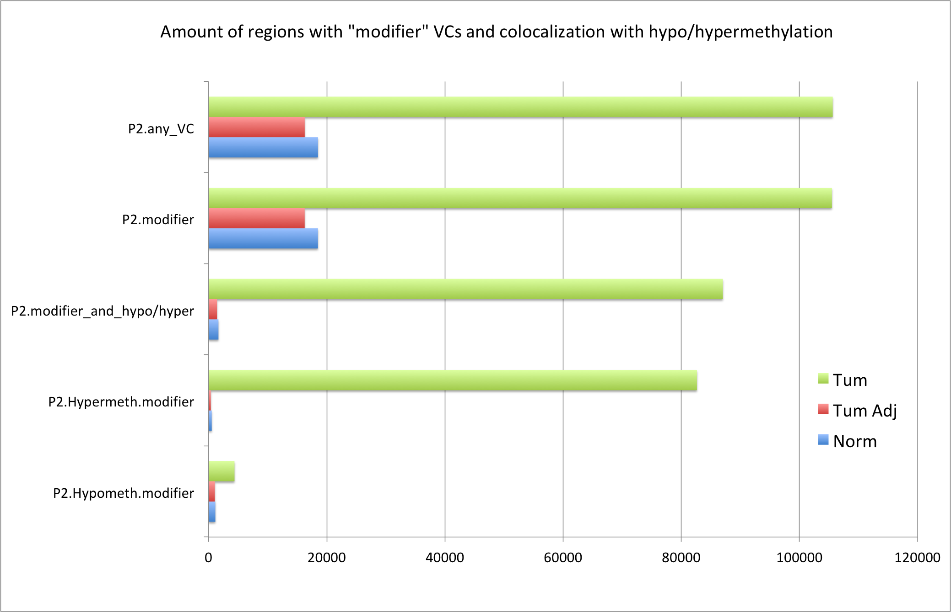
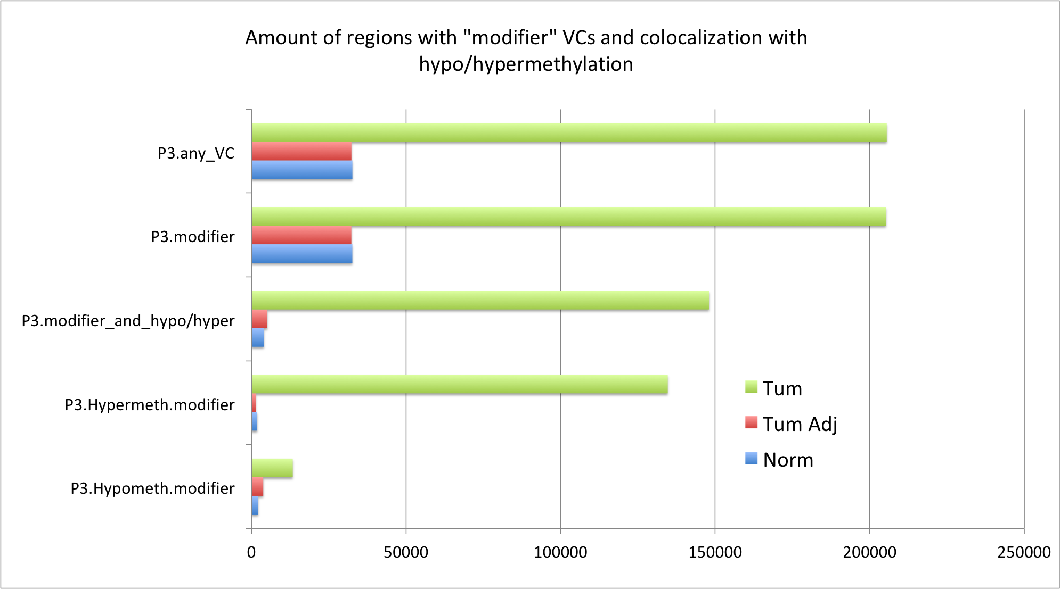
Variant Calls colocalizing with DMRs

Slide 19
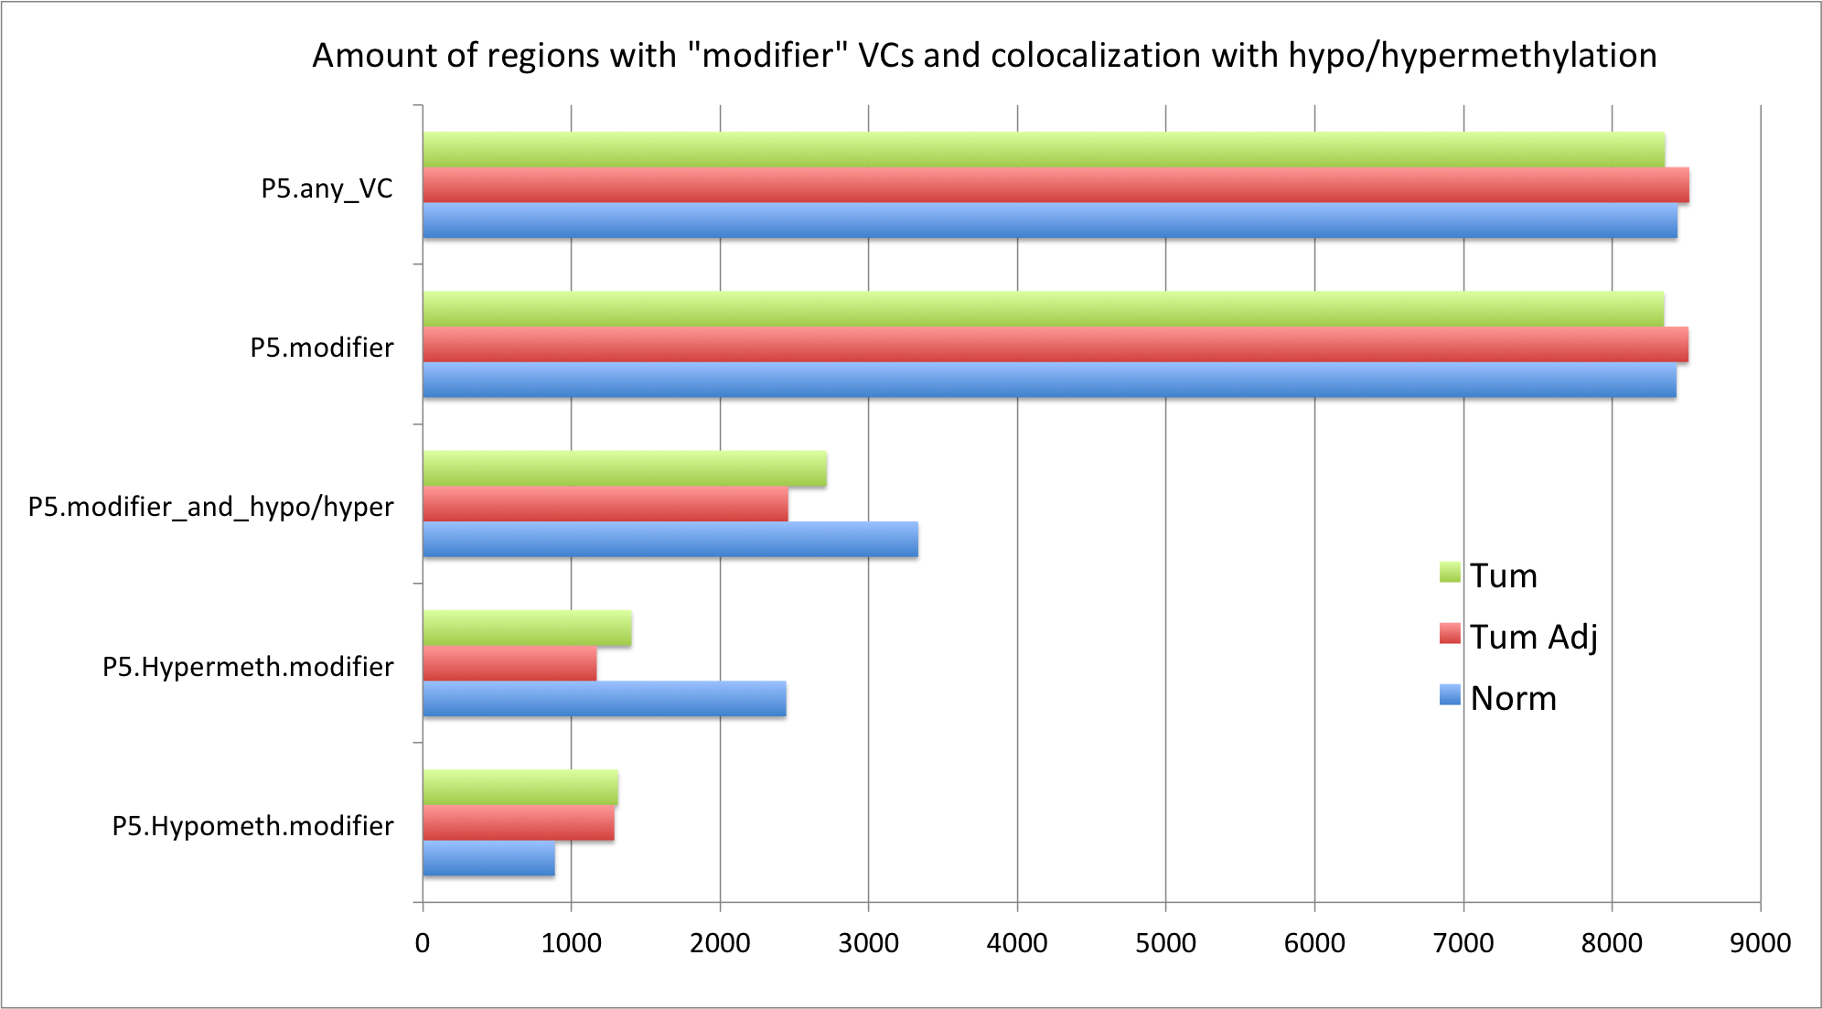
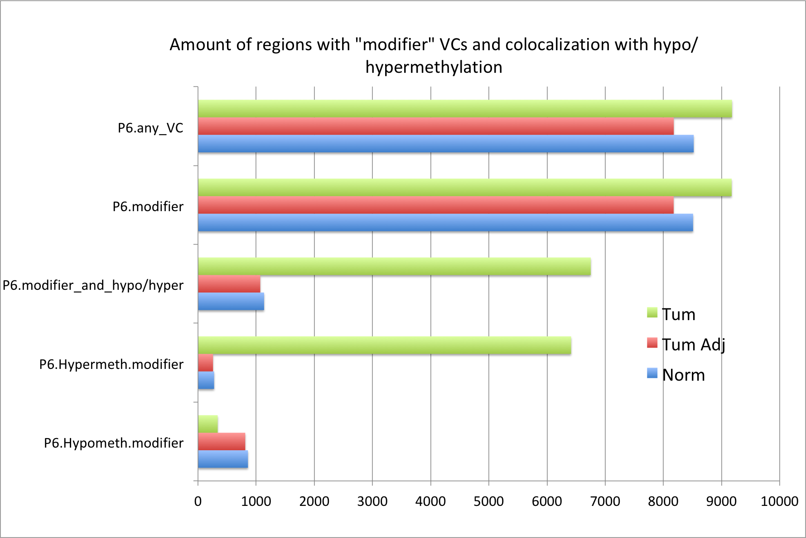
Variant Calls colocalizing with DMRs the undermutated tumours

Slide 20
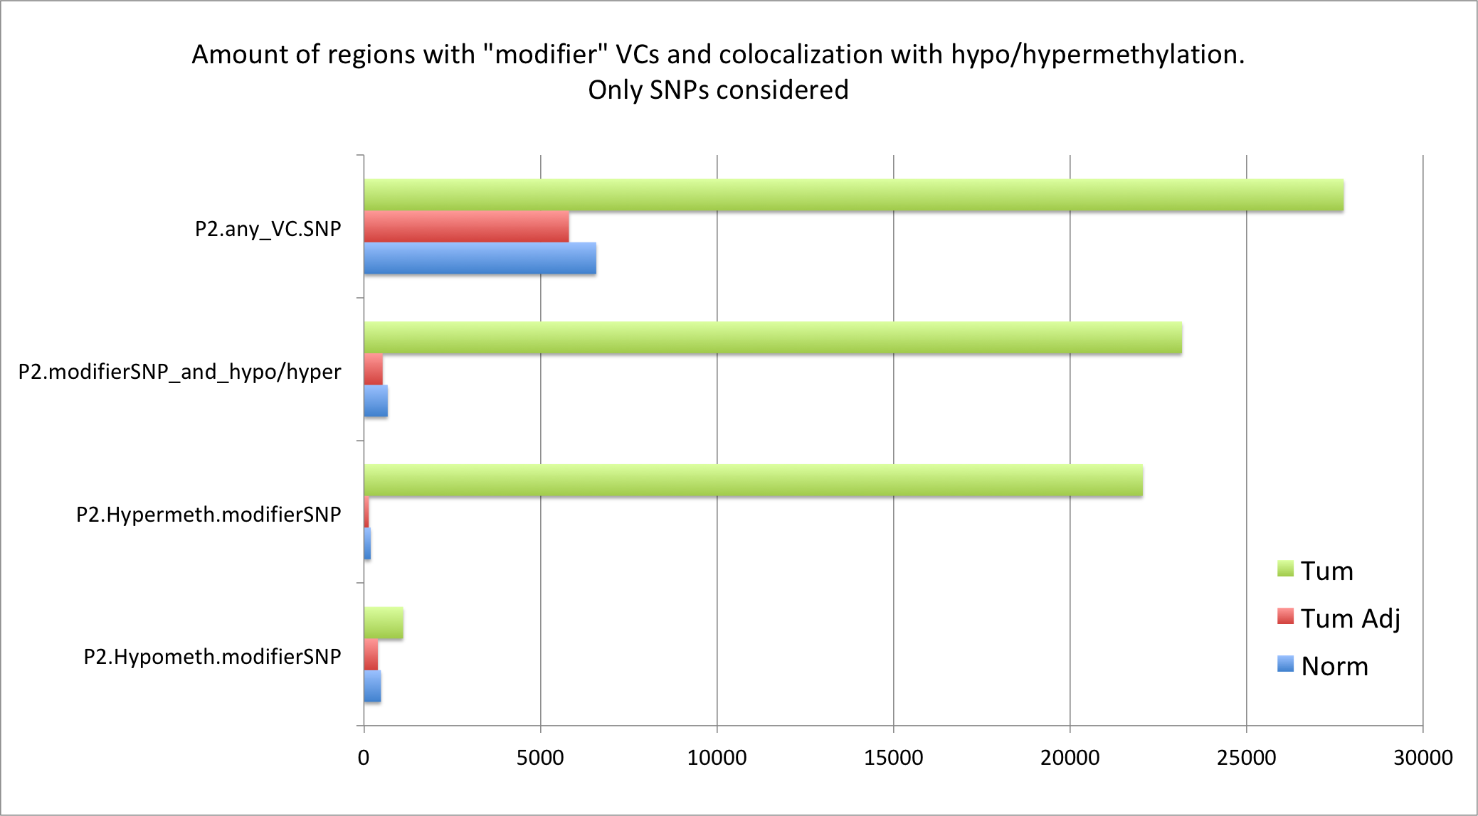
Robustness check 1: only consider SNPs

Slide 21
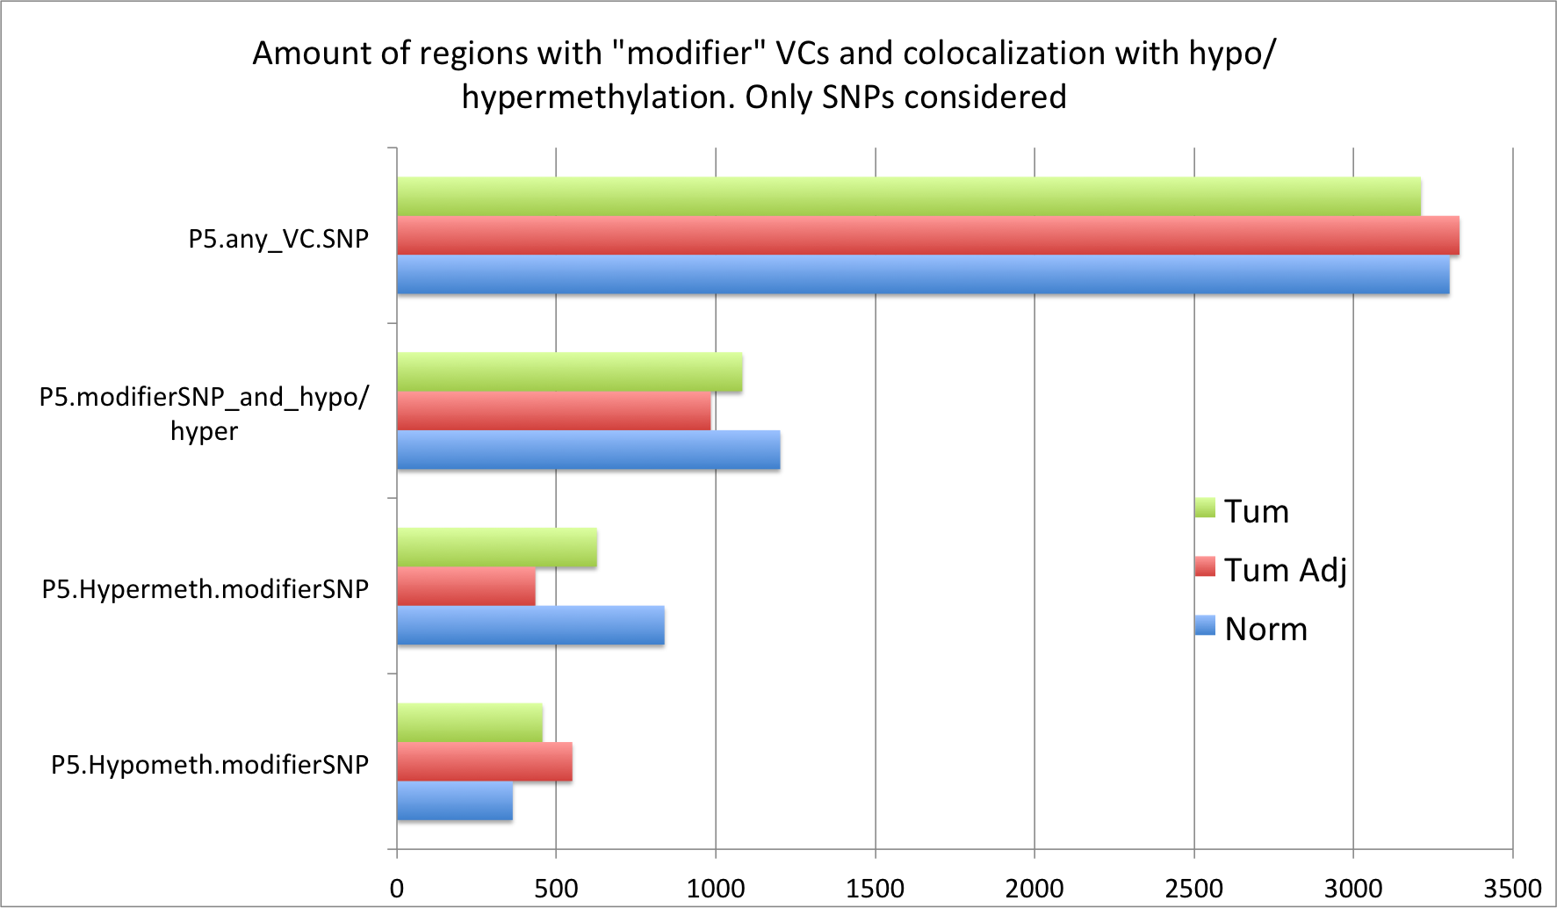
Robustness check 1: only consider SNPs

Slide 22
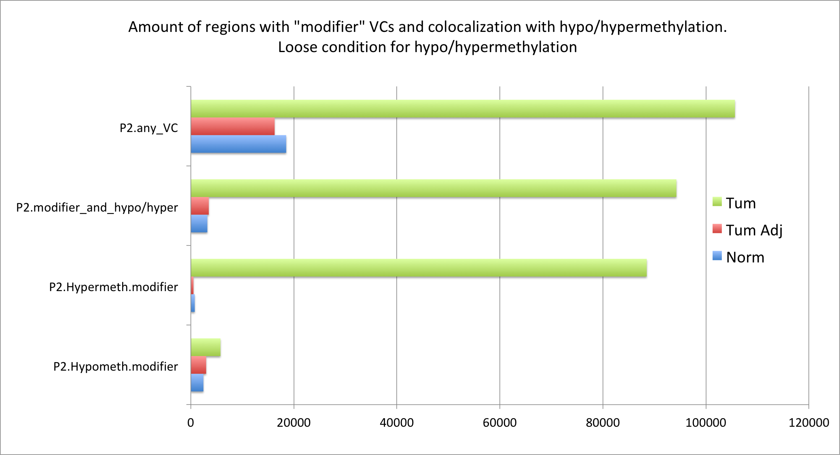
Robustness check 2: Loosen criteria for DMRs

Slide 23
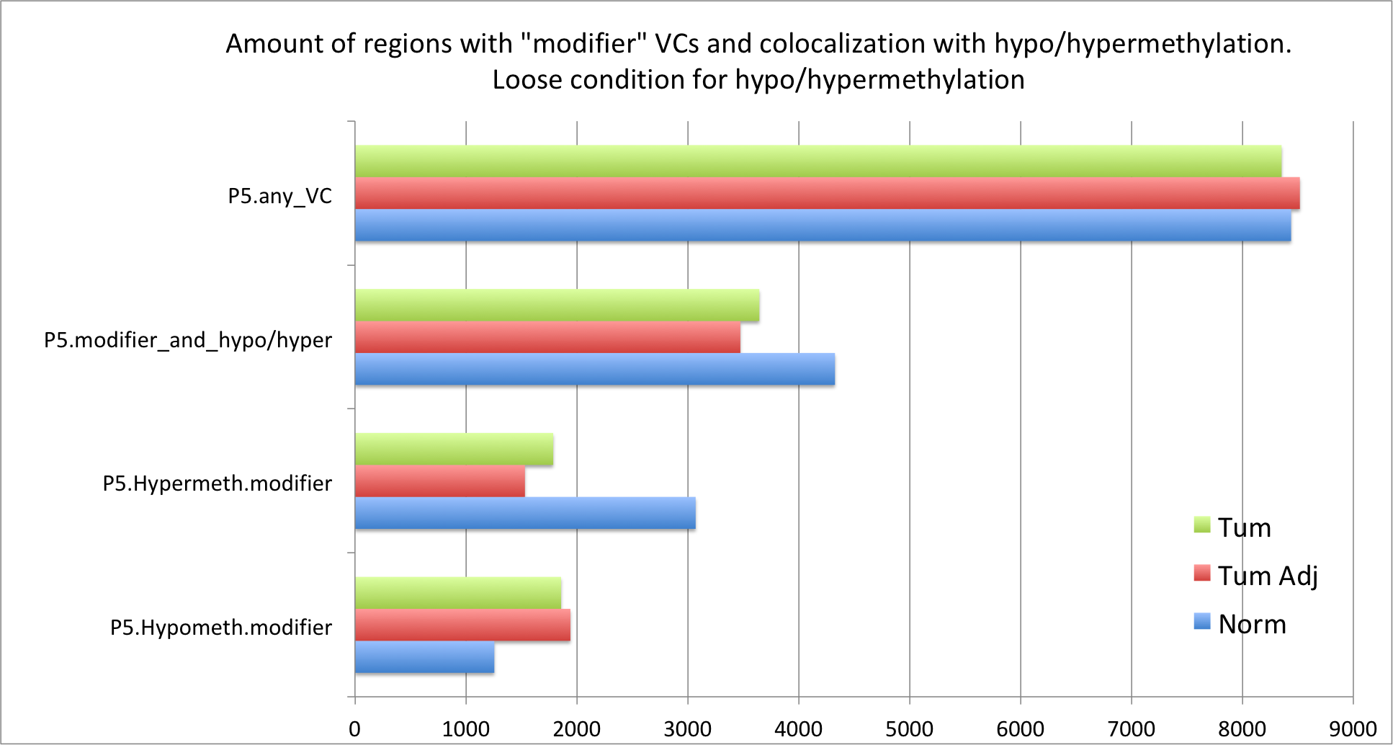
Robustness check 2: Loosen criteria for DMRs

Slide 24
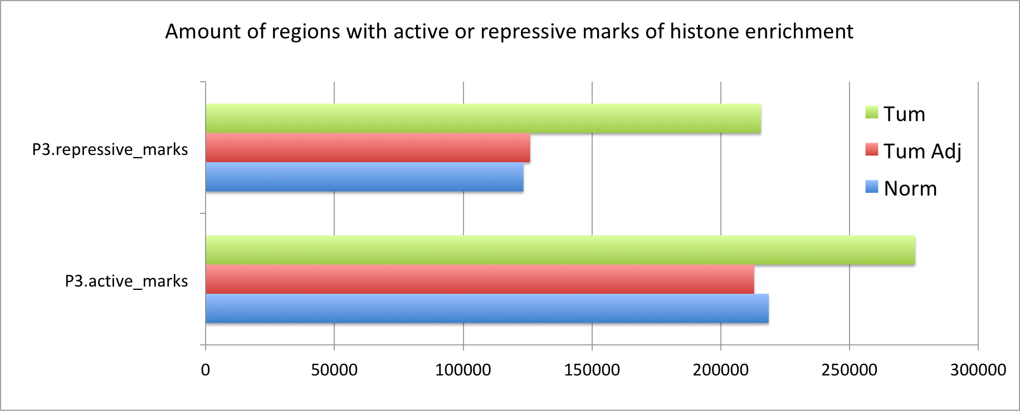
Histone Mods

Slide 25
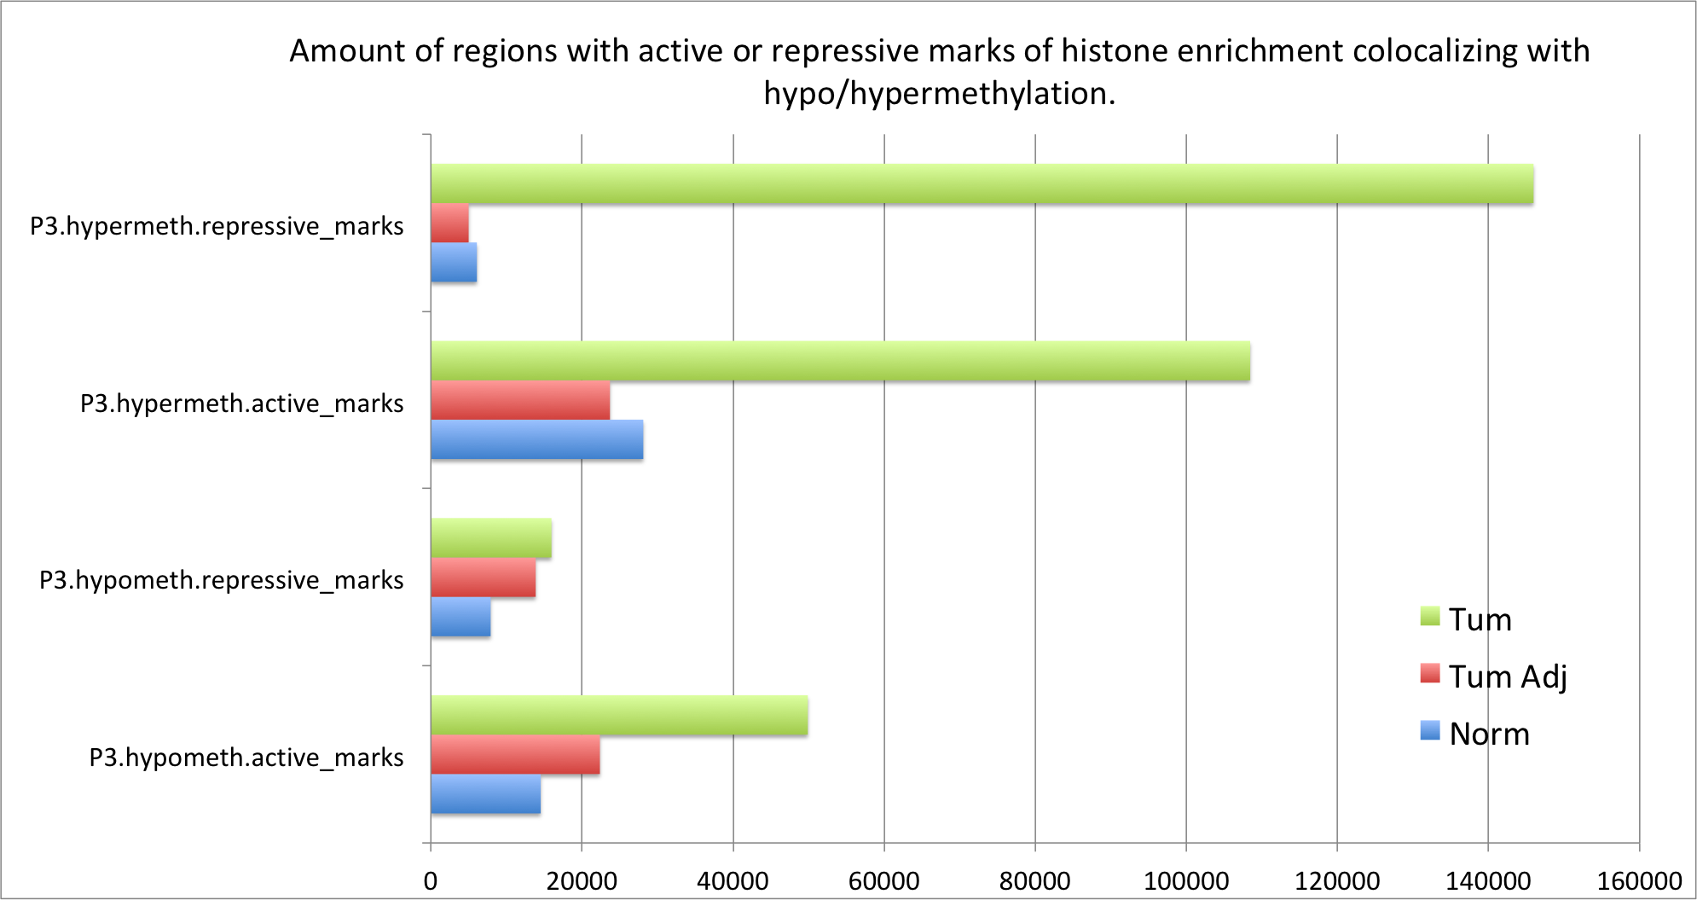
Histone Mods

Slide 26
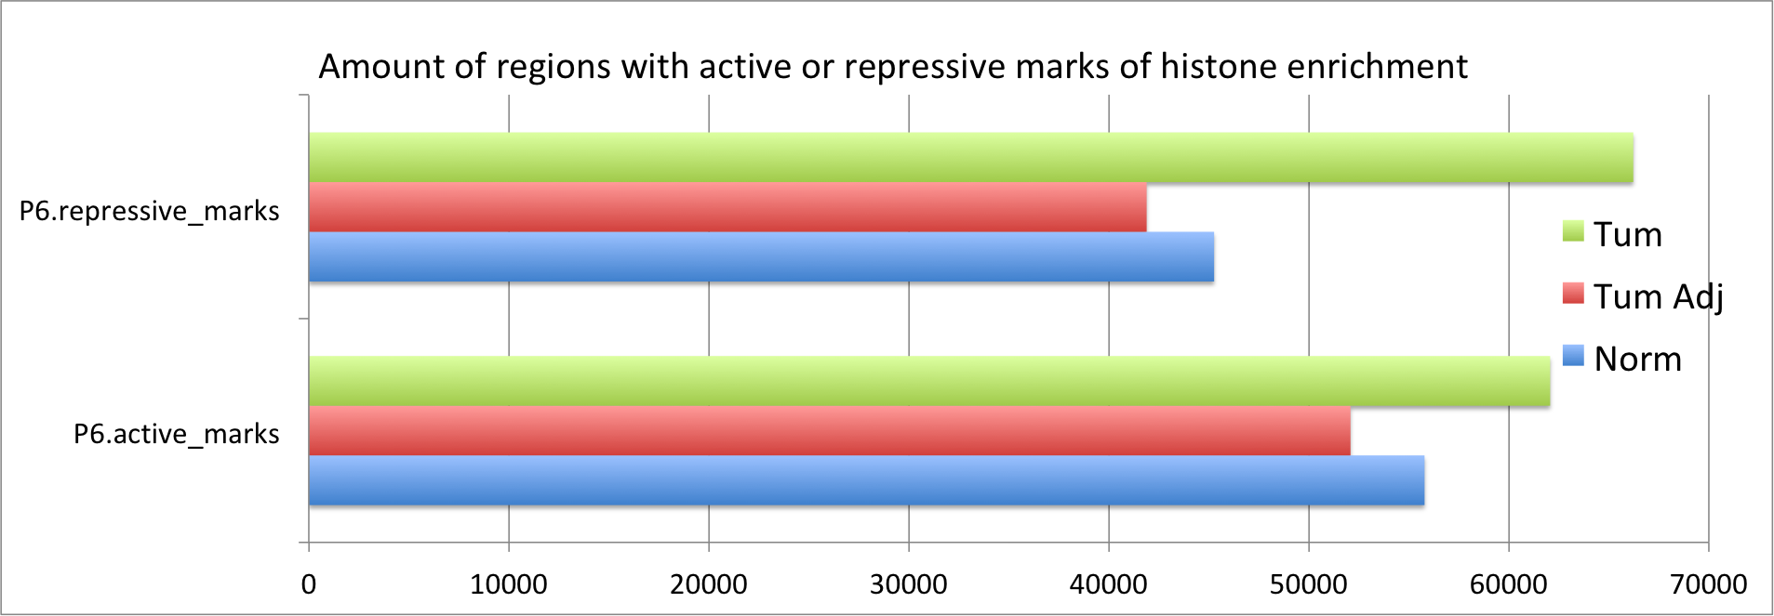
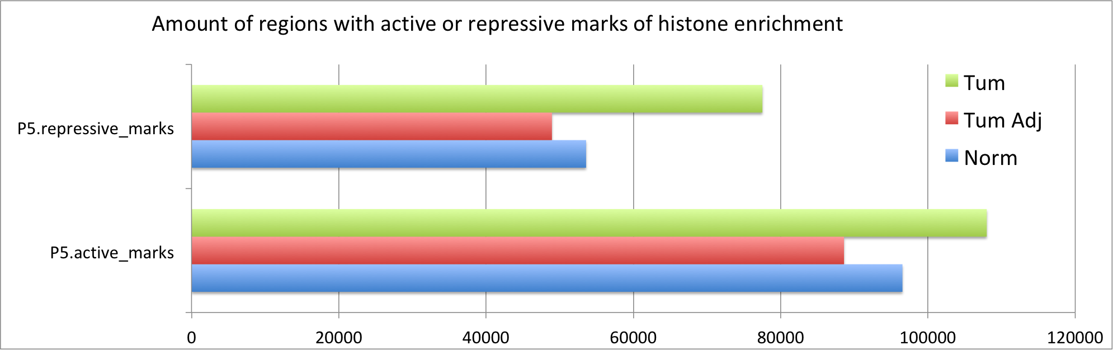
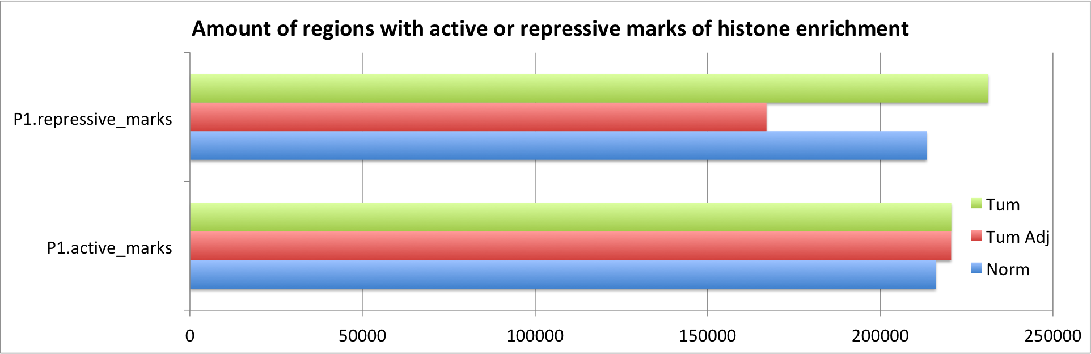
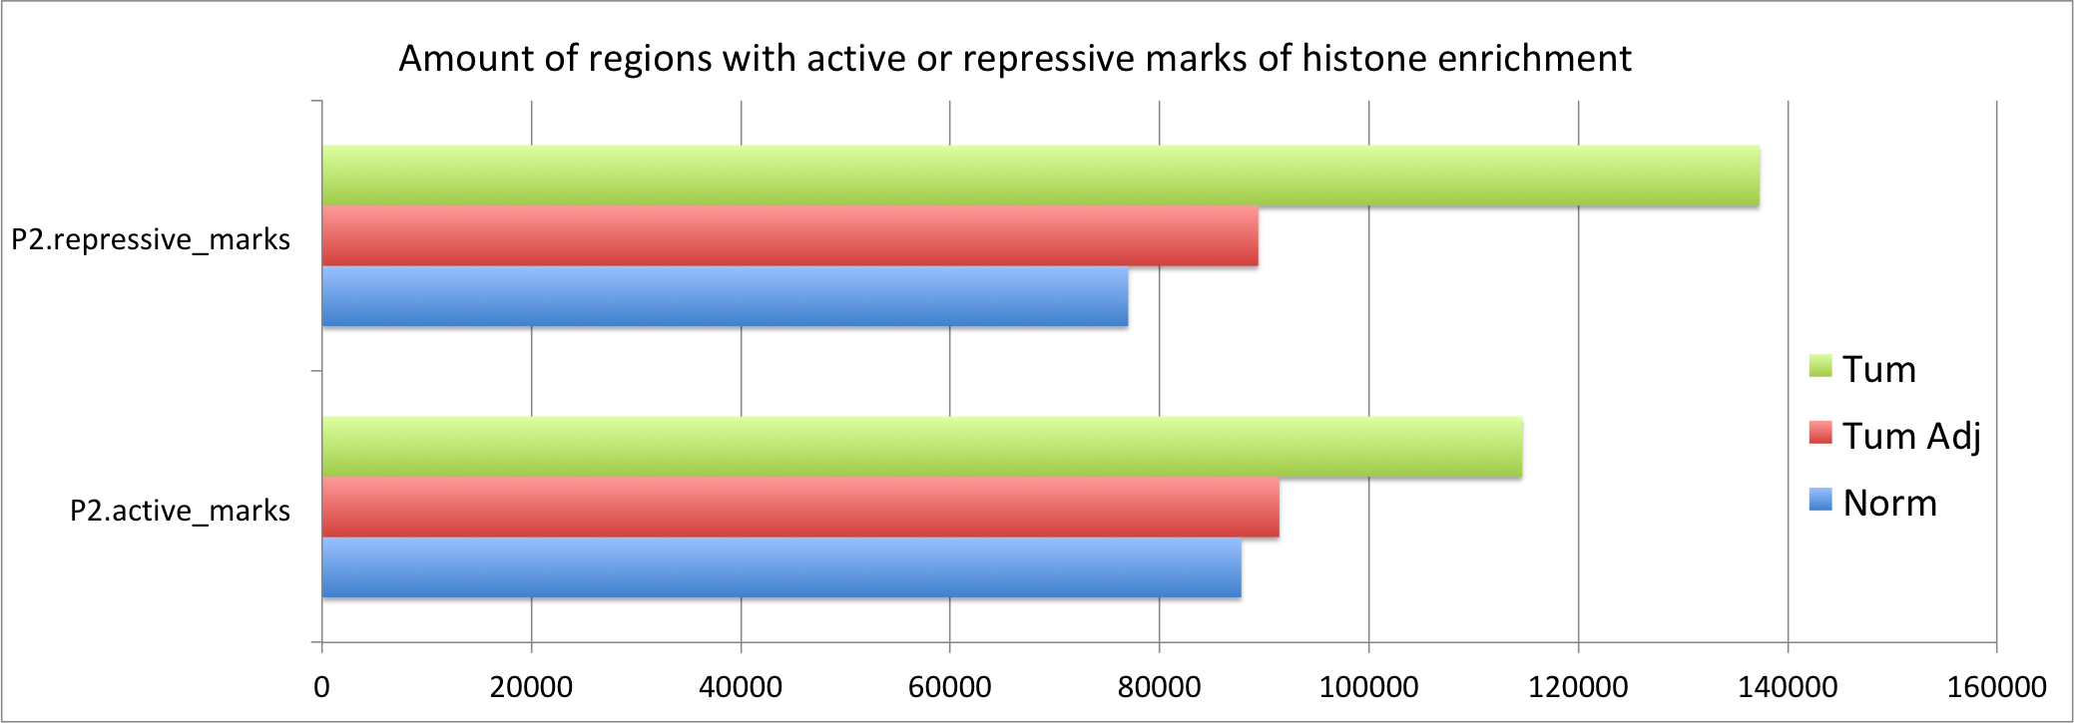
Histone Mods

Slide 27
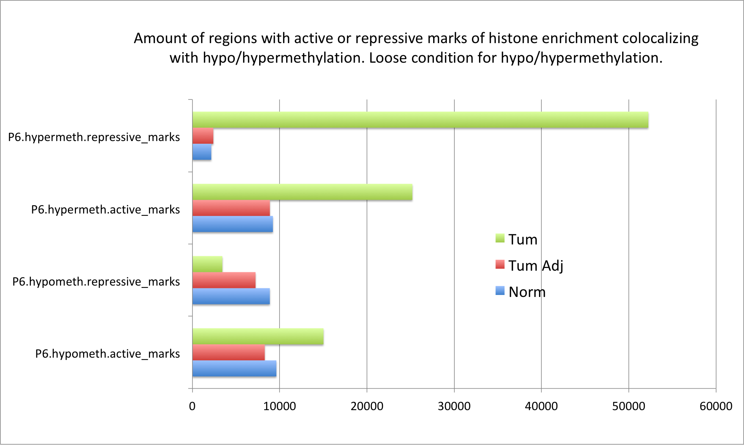
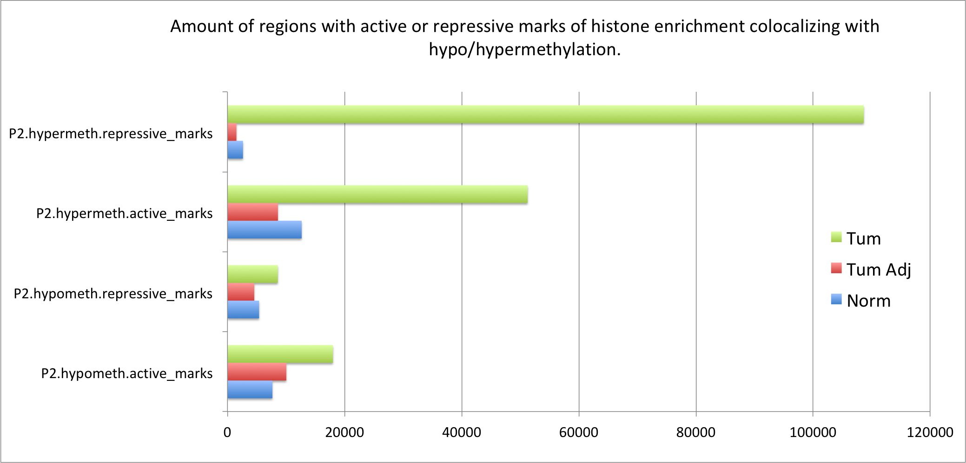
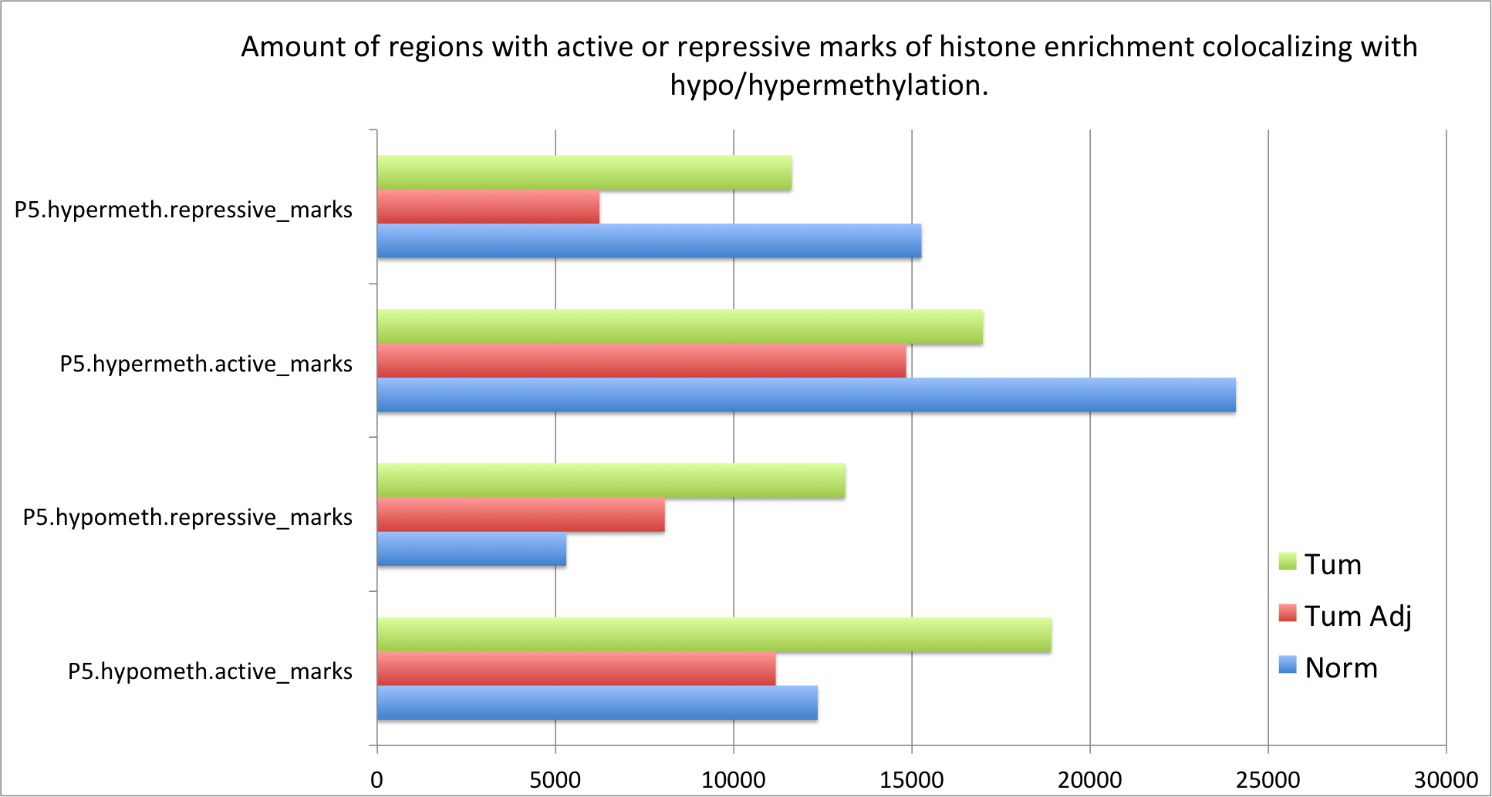
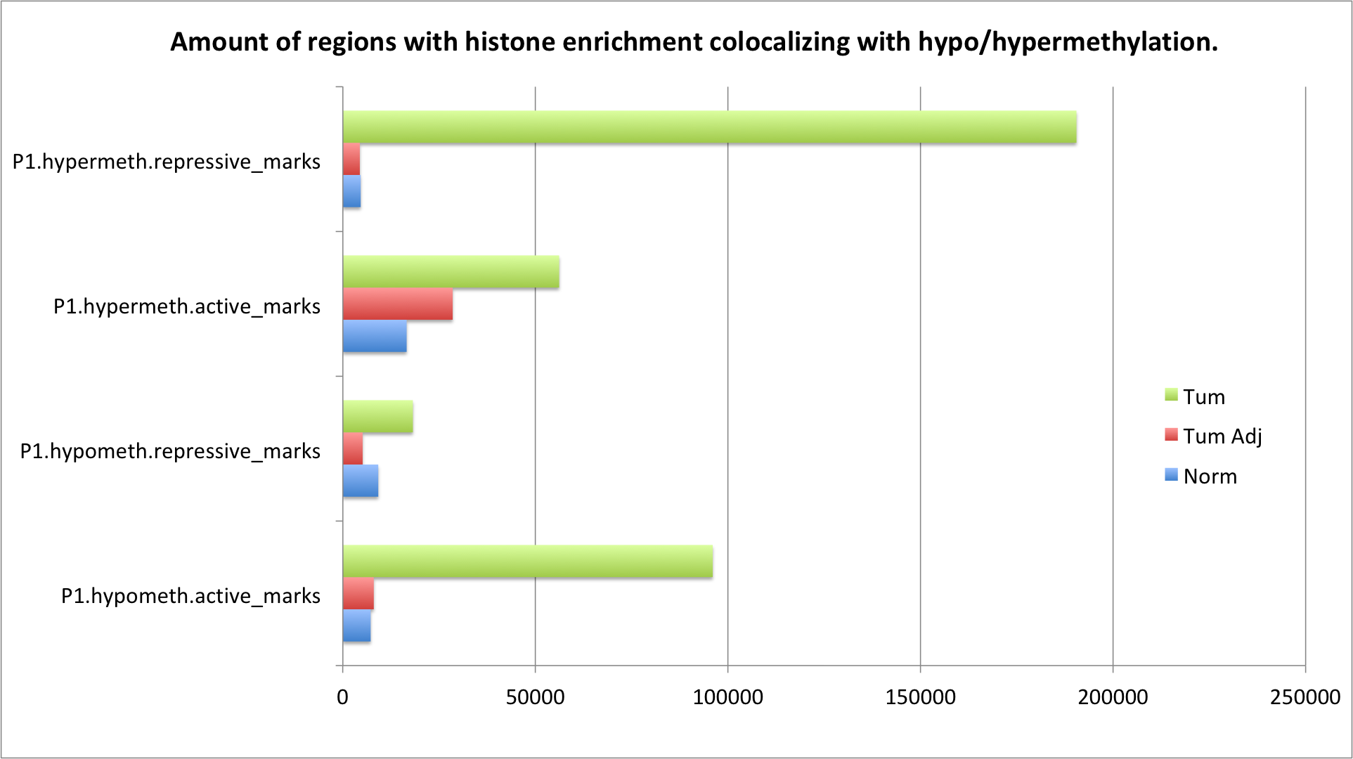
Histone Mods

Slide 28
Complementary slides

Slide 29
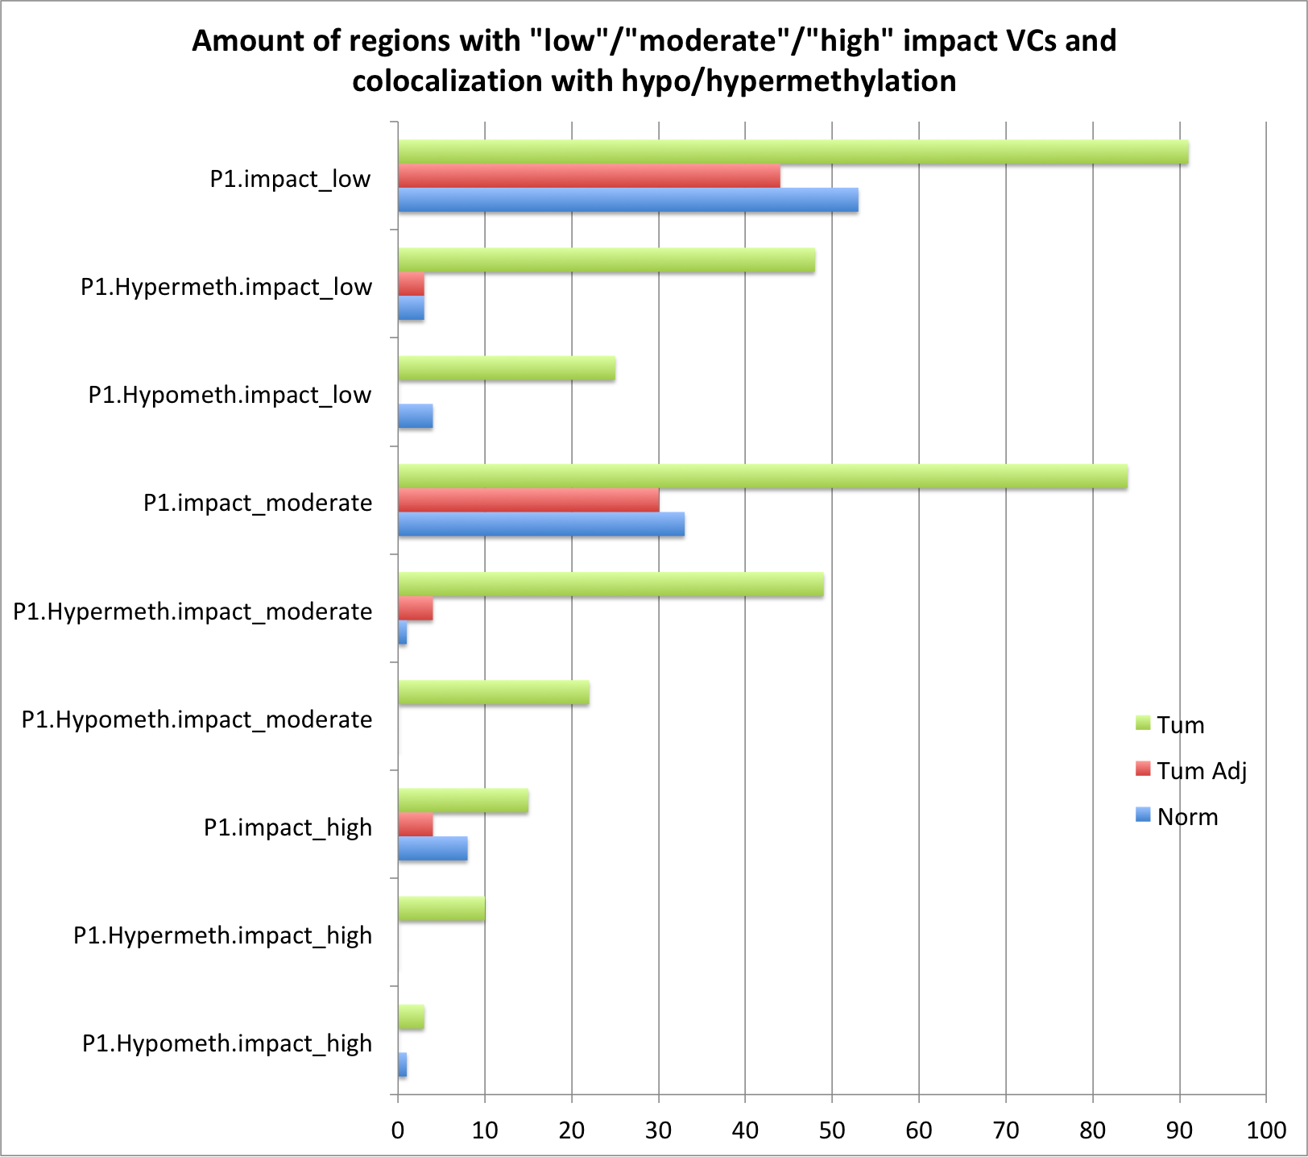

Slide 30
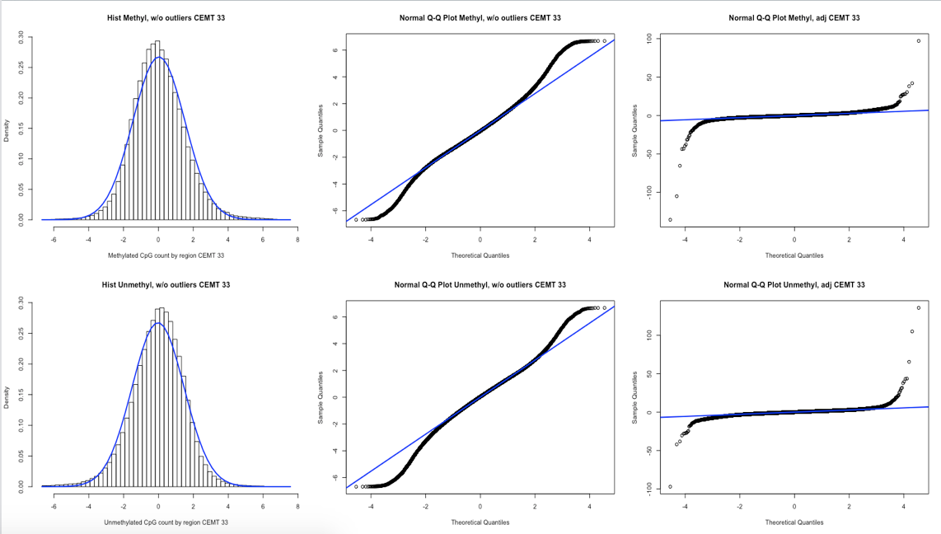
The Analysis
1) Split genome into 400bp chunks - Defined arbitrary regions for contrasting datasets that localize differently - 400bp is small enough to not envelop multiple functionally different regions 2) DMR - 𝜒2 test on methylation calls - Add counts over 400bp region -> enough coverage for 𝜒2 criteria - Adjusted residual approaches a normal distribution with outliers - Adjusted residual = (O - E) / sqrt(E * (1 - prow) * (1 - pcol)) - 𝜒2 finds DMRs within group: - All from same patient -> Test contribution of models with and without cancer - All Normal and Tumour-adjacent samples -> baseline in normal tissue - All Tumour samples -> baseline in cancer tissue 3) DHM - Enriched regions from FindER - BED file with 3 columns: Chromosome | Region Start | Region Stop - Set 1 for genome chunks that overlap with enriched regions listed 4) VCs - query VCFs to list variants - obtain genotypes, zygosity and functional annotation - contrast tumour and normal samples to isolate somatic mutations - count the amount of mutations in each genome 400pb chunk 5) Count VCs close to or within DMRs, DHMs, or both. - Other samples’ VCs serve as statistical baseline - If models 1 and 2 hold, VCs co-locate with DMRs and DHMs, so count is higher than baseline - Analysis shows a connection between DMR and VCs
DMR1 and VCF1:
DMR1 and VCF2:

Slide 31
Same sample
Same patient but other sample
Other patient

Slide 32
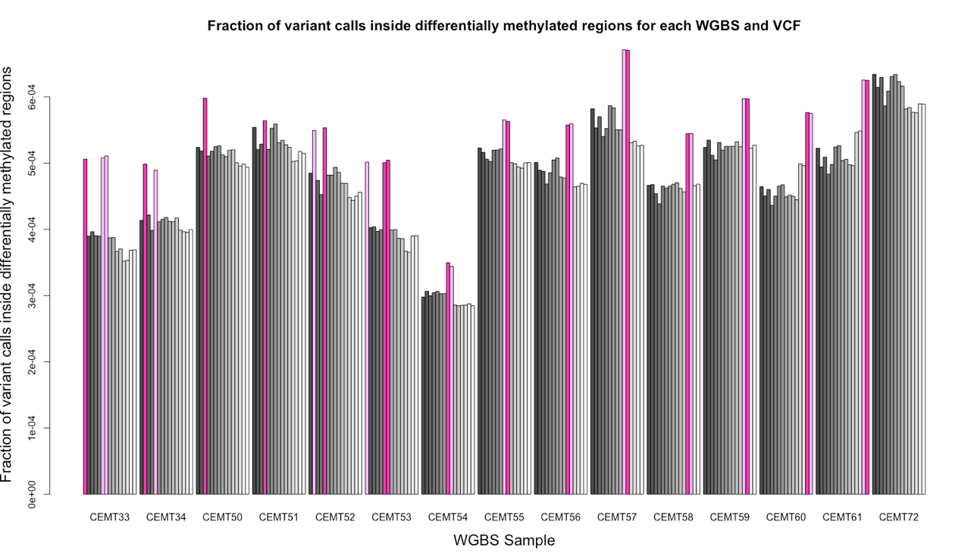
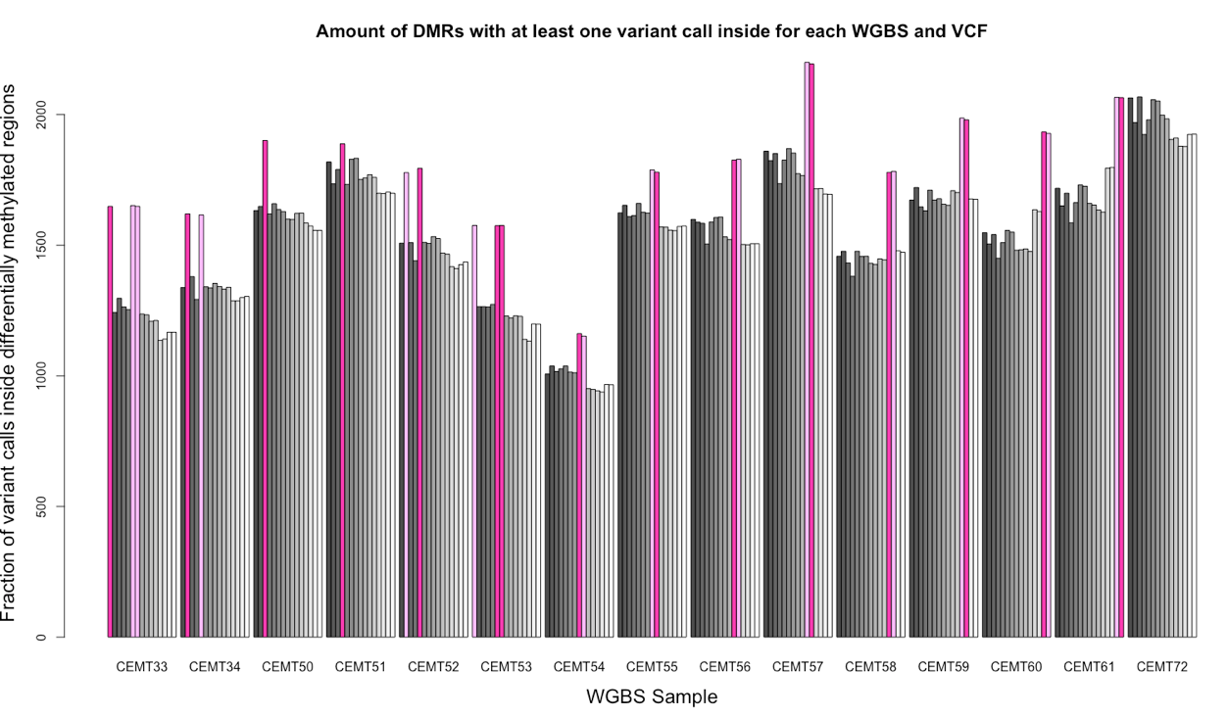
Same sample
Same patient but other sample
Other patient

Slide 33
Same sample
Same patient but other sample
Other patient

Slide 34
Next steps?
Include DHM to improve baseline
Include VCF functional annotation (test models 1 and 2)
Redo with multiple chunk sizes (improve coverage)
Run analysis for each group
All from same patient -> P1 (34, 52, 62), P2 (33, 53, 63), P3 (54, 55, 64), P4 (56, 57, 65), P5 (58, 59, 66), P6 (60, 61, 67)
All Normal and Tumour-adjacent samples -> Norm (33, 34, 52, 53, 54, 55, 56, 57, 58, 59, 60, 61)
All Tumour samples -> Tum (62, 63, 64, 65, 66, 67)
For regions identified, investigate RNA and miRNA expression
How to obtain position from coverage files?

Slide 35
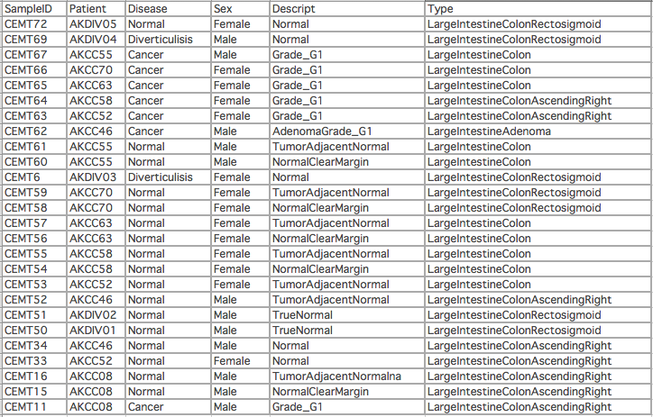

Slide 36
Probing data
By raising the thresholds for DMRs we select for regions where multiple CpGs are regulated differentially, so the biological effects are amplified relative to technical artifacts from VCs confounding WGBS alignment.
As selectivity increases, spatial correlation decreases. Suggests that:
More unique DMRs are not genetically determined
Spatial correlation was likely a technical artifact

Slide 37
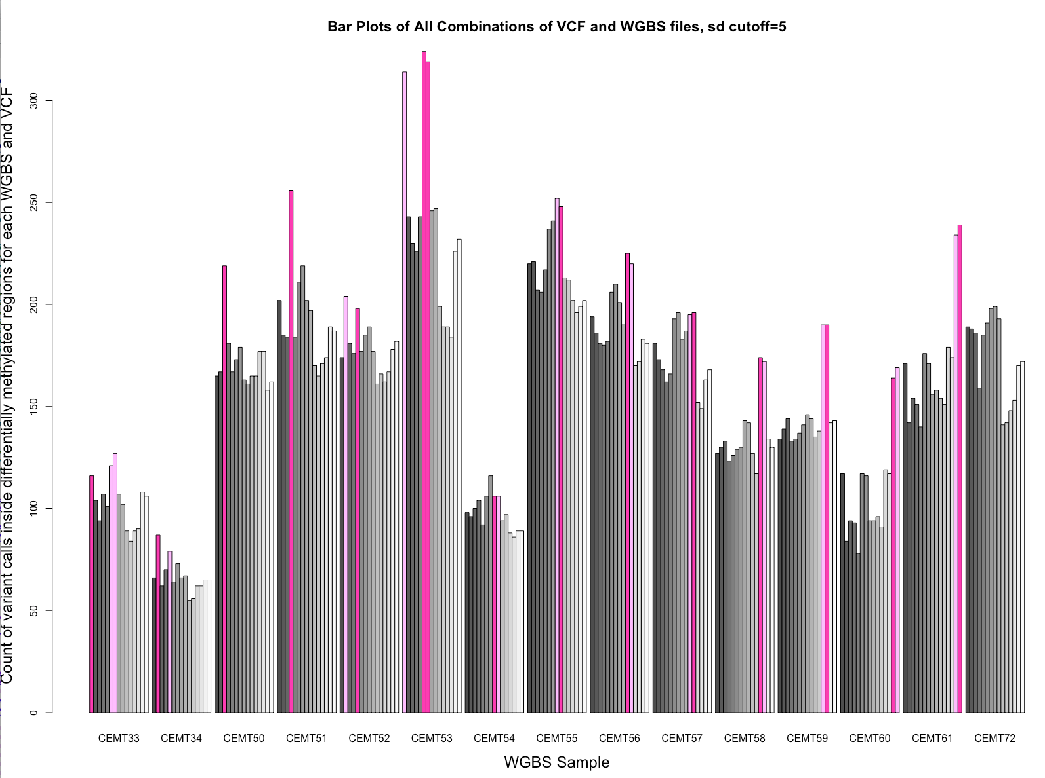
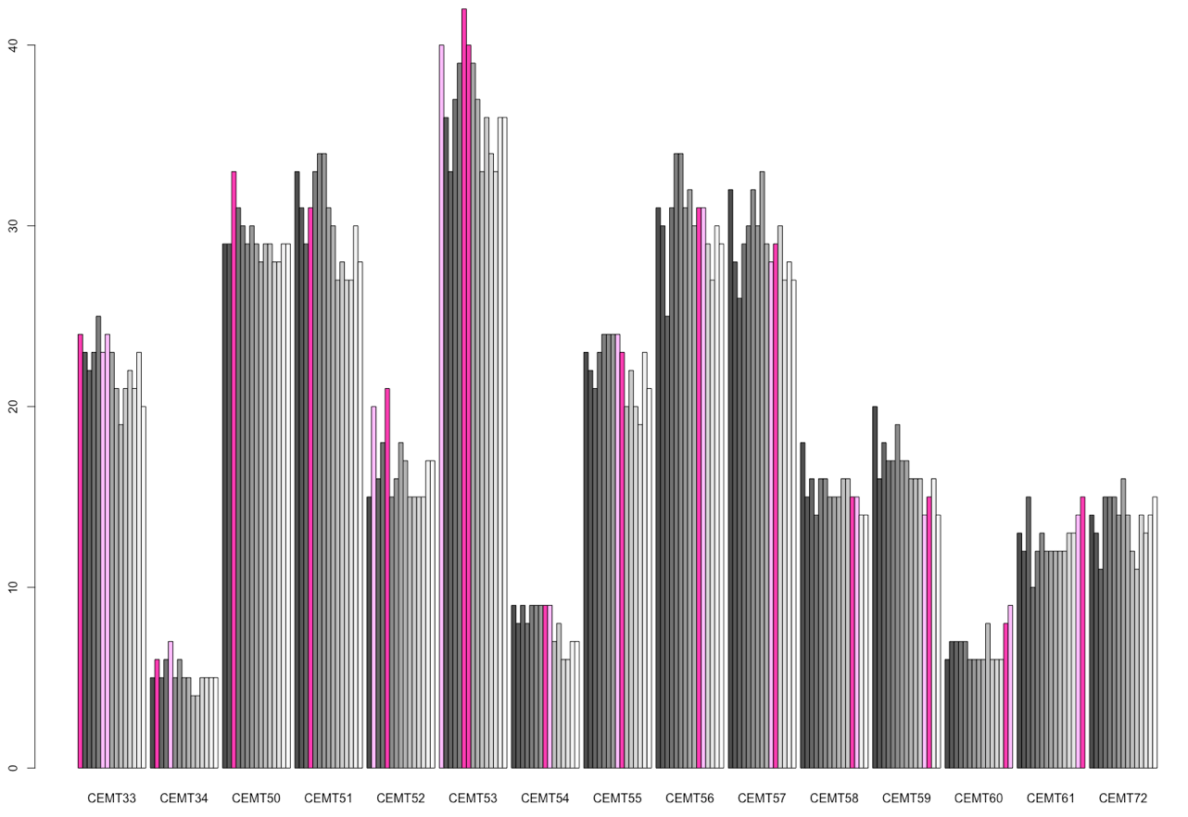
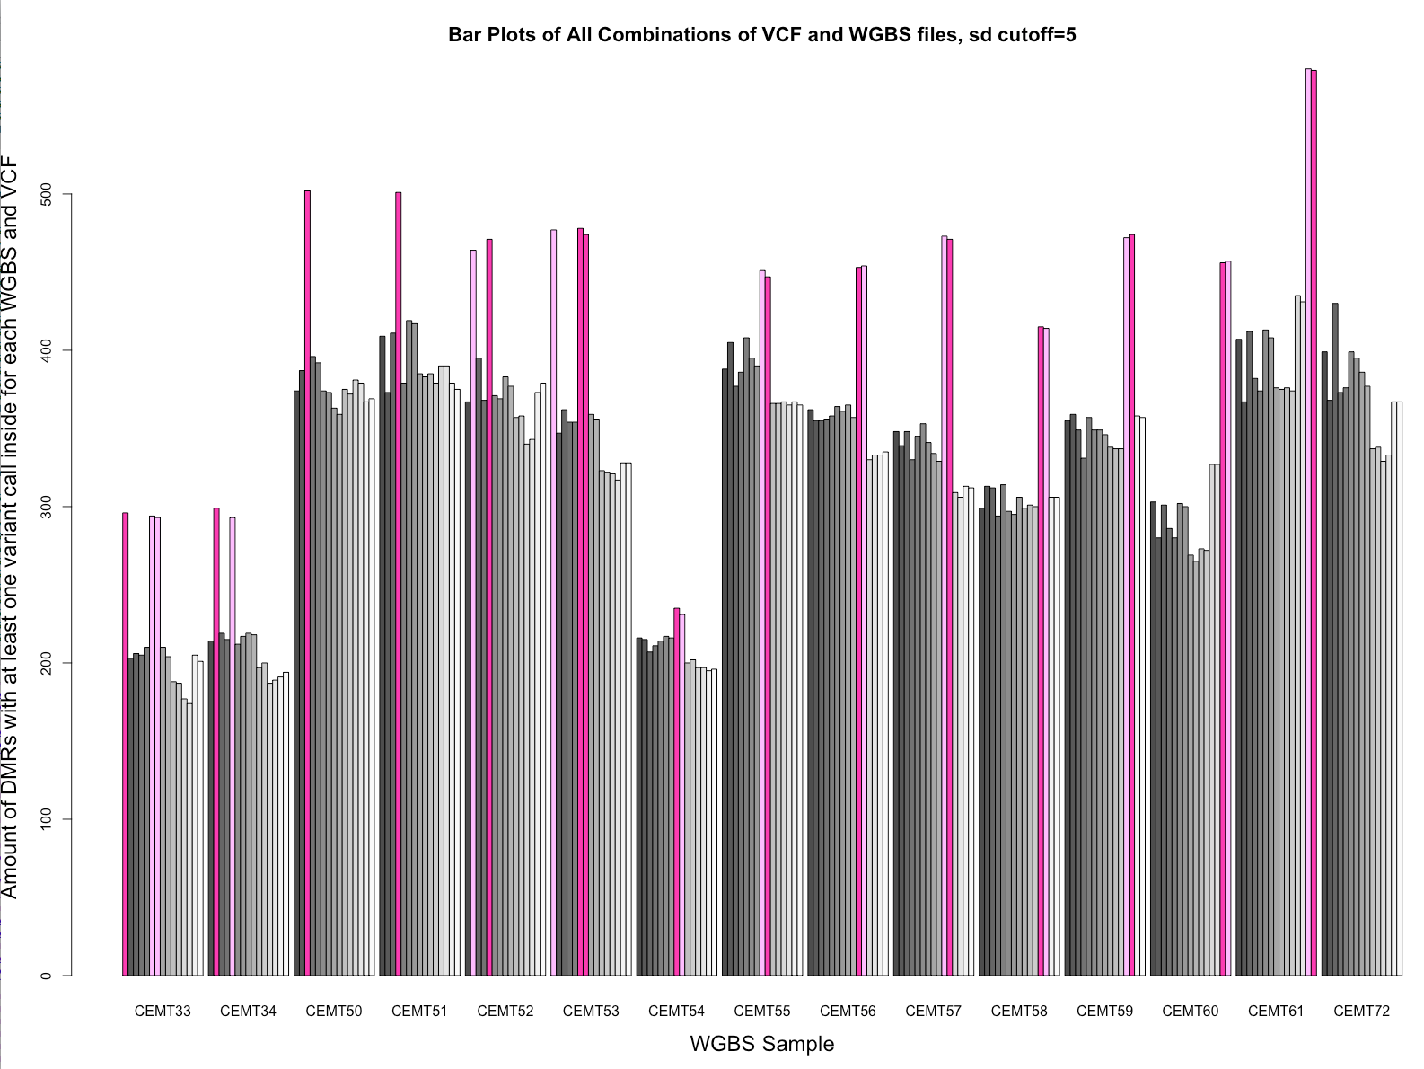
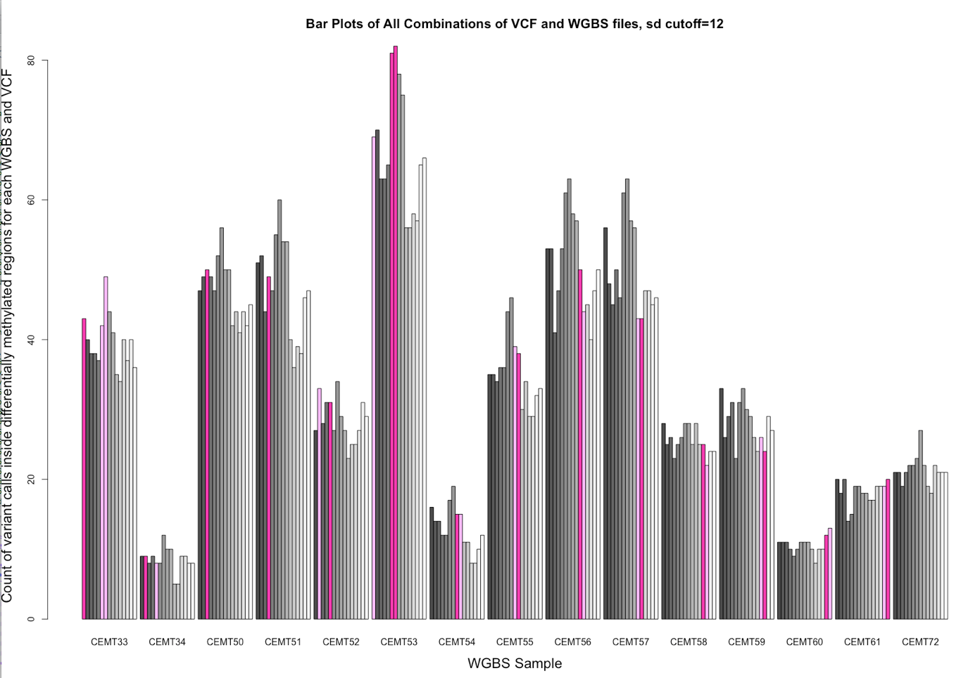
Residual > 1.96*sd
Residual > 5*sd
Residual > 12*sd
Count of VCs inside DMRs
Count of DMRs with a VC inside

Slide 38







Slide 39
QC
File | # Rows
CEMT Methyl BED original data | 58,588,398 - 58,607,722
CEMT 33 Methyl BED non-null | 23,185,884
CEMT 33 VCF | 4,348,573
join of all 15 CEMT Methyl BED | 711,498
DMRs (50bp each) for CEMT33 | 2484 (cov=124,200bp)
Human genome | 3,200,000,000bp
Size probing of regions for methyByRegion on CEMT 33
region=50; rows=5,847,330; coverage=292,366,500
region=100; rows=4,473,868; coverage=447,386,800
region=200; rows=3,117,795; coverage=623,559,000
region=400; rows=3,396,255; coverage=1,358,502,000
region=1000; rows=1,908,876; coverage=1,908,876,000

Slide 40


Tony’s analysis: significance of genetic variants from clustering
Concordance affects up to 2kb distance (Tony)
QTLs significantly affect up to 1Mb distance (Zhang 2010)
Toni removed 200bp around genetic variants, but that is unlikely to cover all contributions of a QTL
Also, the fact that clustering occurs by cell type demonstrates other unique patterns, but not that genetic patterns are irrelevant
Still a defining feature, so still contributes to the clustering

